Slide 1
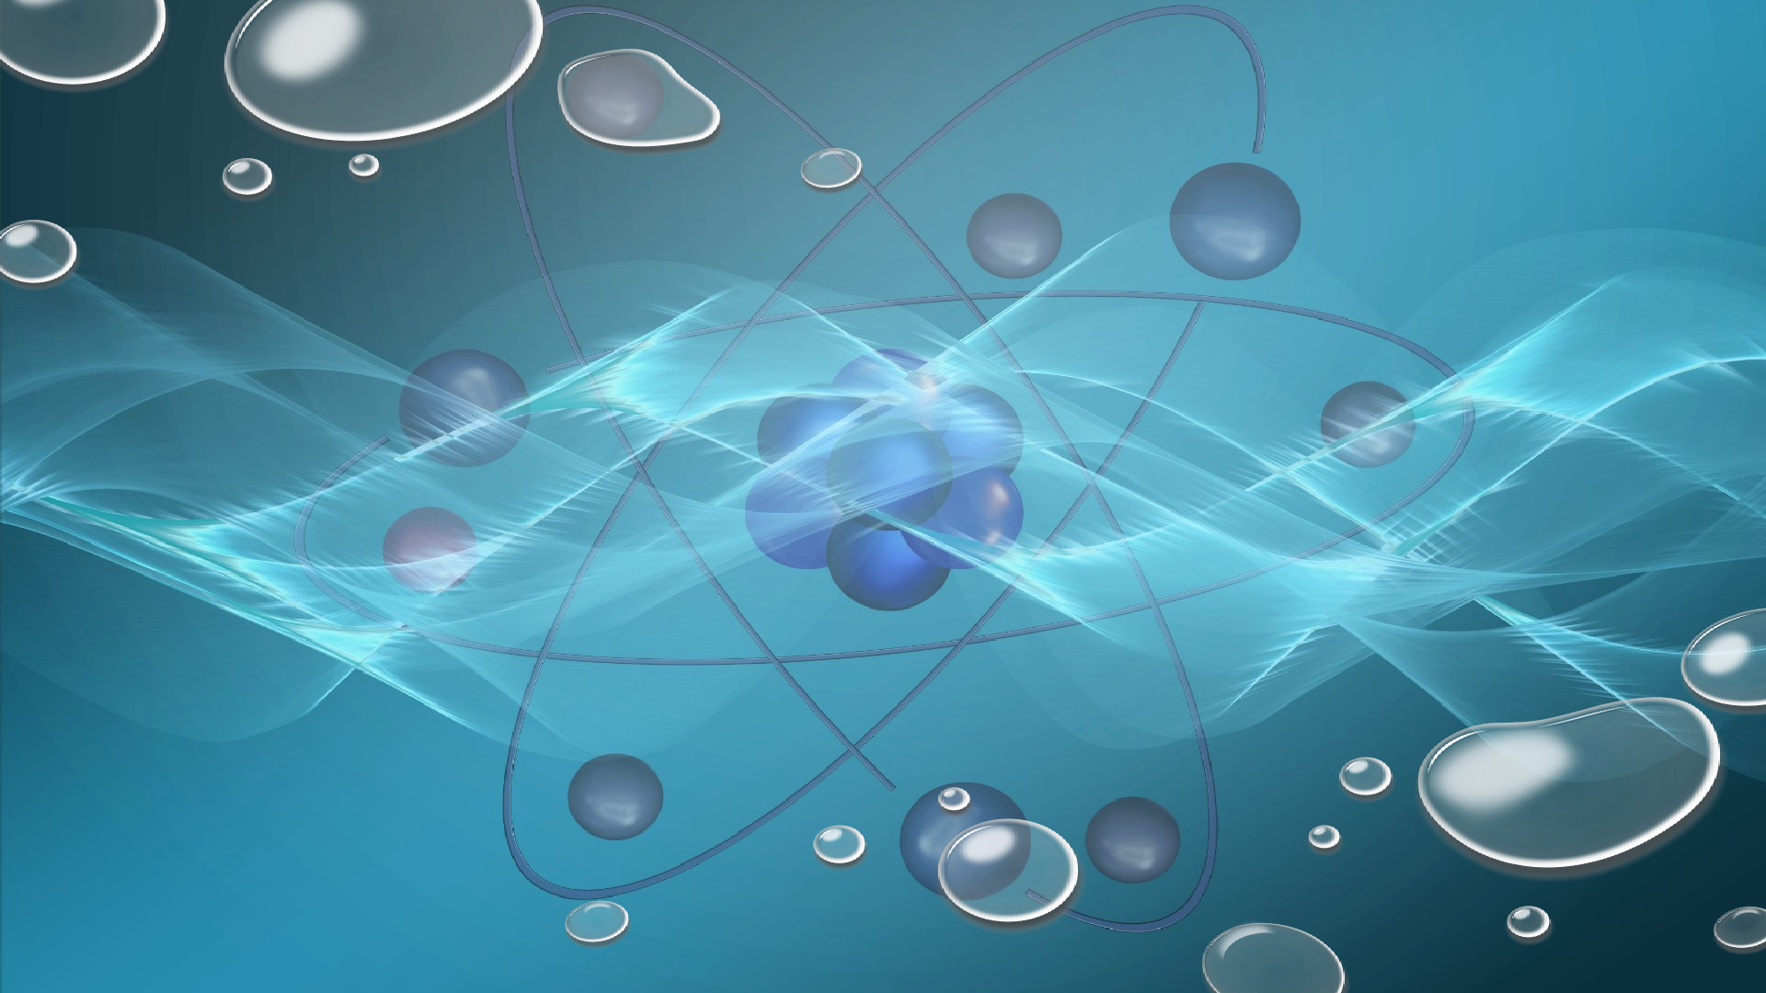
TO INVESTIGATE THE THERMOLUMINESCENT PROPERTIES OF SYNTHESIZED NANOPHOSPHORS FOR USE IN RADIATION DOSIMETRY
By:
Meemik Roy
Sri Venkateswara College, Delhi University
Under the guidance of:
Prof. Anant Pandey
Professor, Department of Physics
Sri Venkateswara College,
University of Delhi

Slide 2

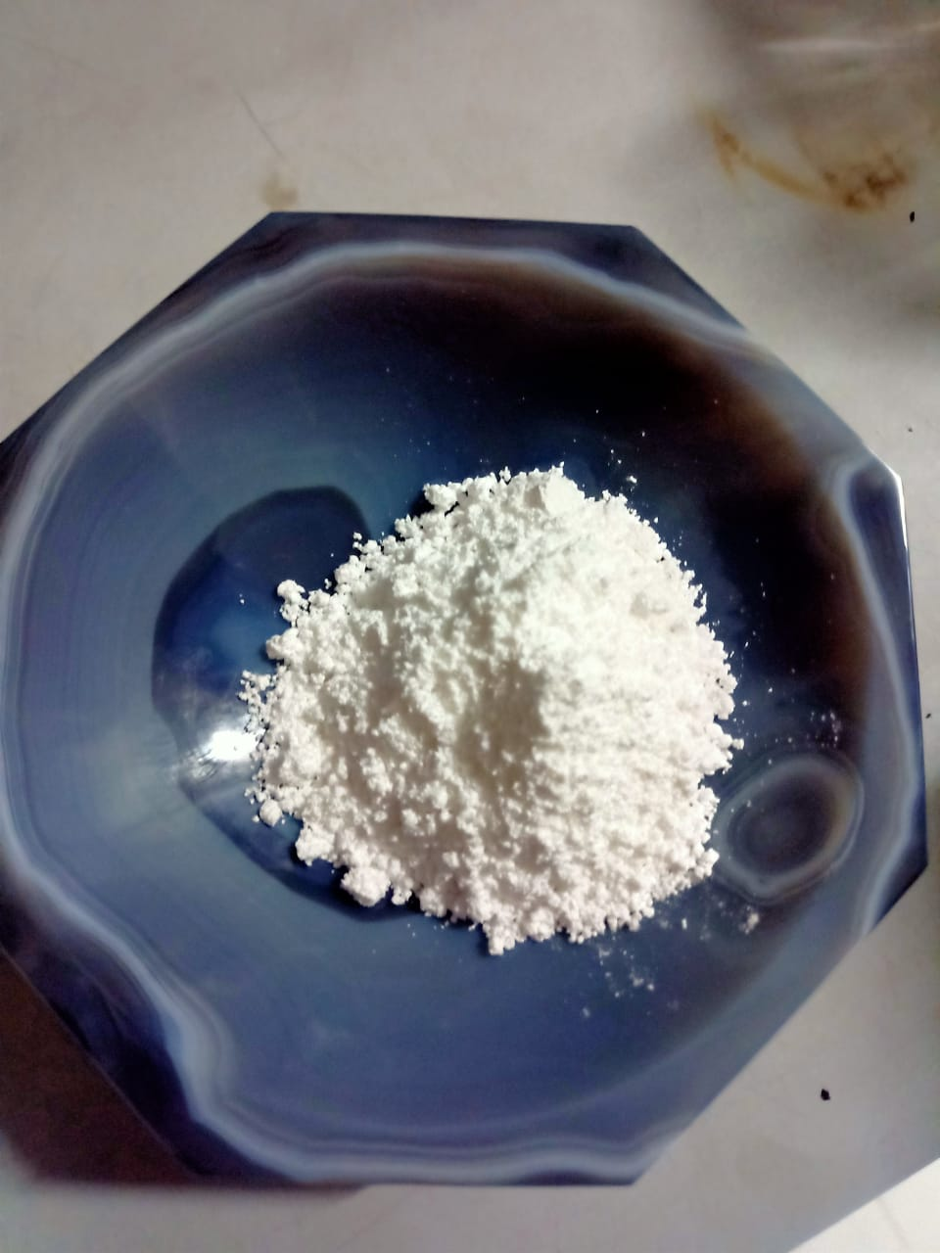
1 Introduction
2
Thermoluminescence Dosimetry
3
Lithium metasilicate
4
Calcium sodium sulphate
5
Conclusion

Slide 3
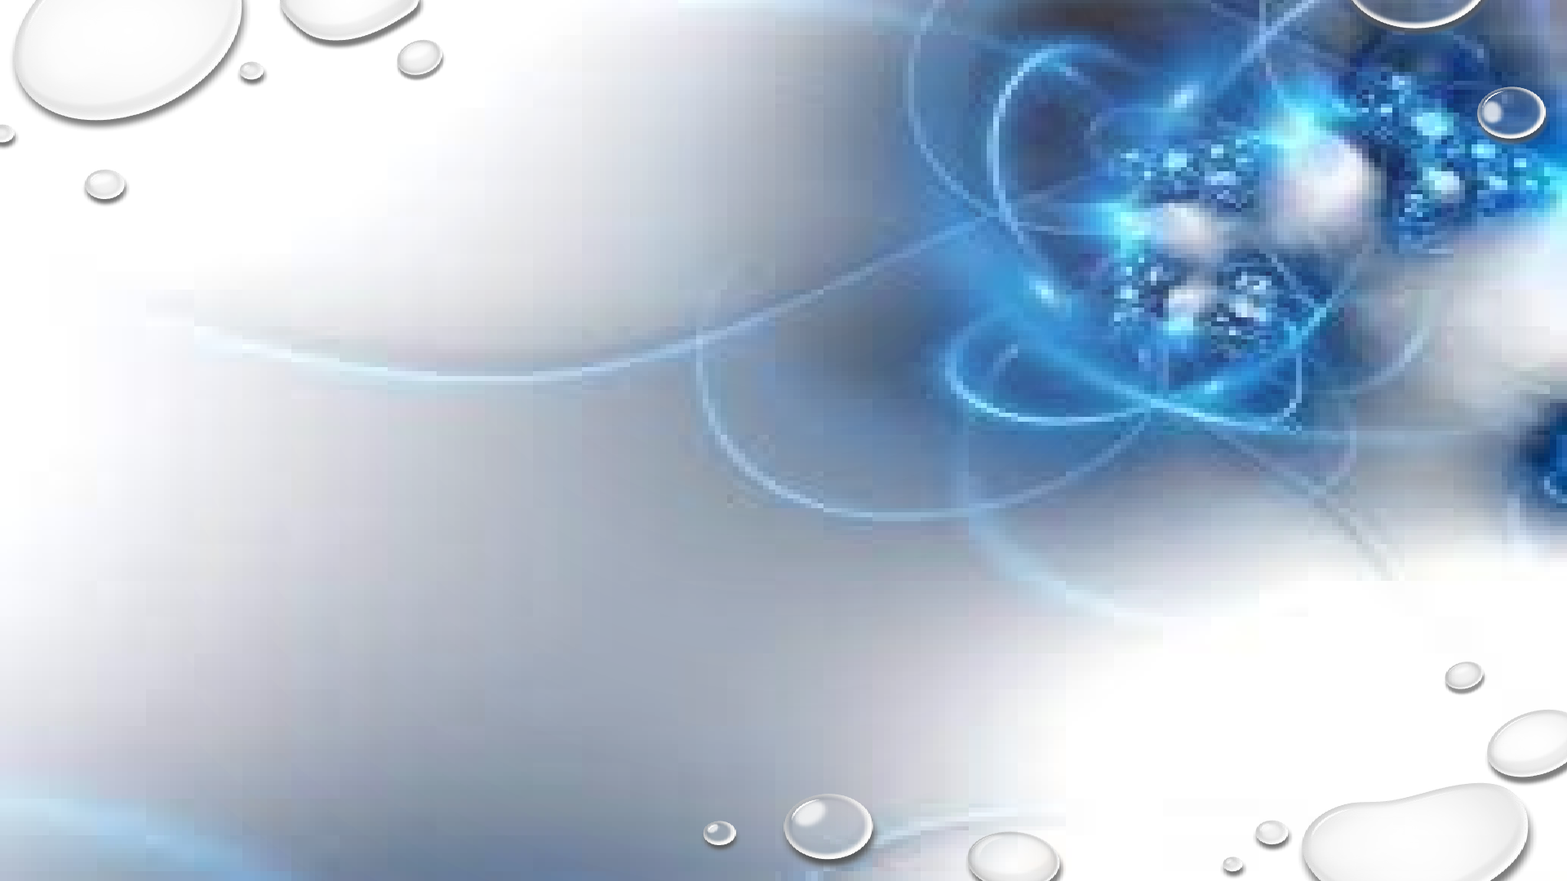
Introduction

Slide 4

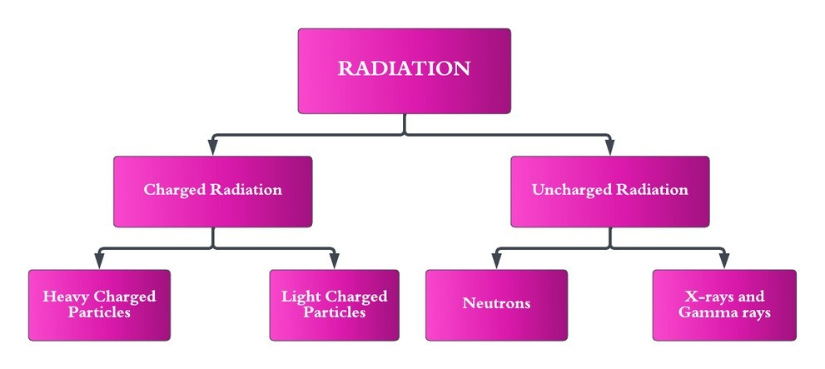
RADIATION
Radiation is the transfer of energy through electromagnetic waves or subatomic particles.
Understanding the nature, types, sources, and effects of radiation is essential for ensuring its safe and responsible use.
RADIATION DOSIMETRY
Radiation Dosimetry is the science and practice of measuring and assessing the dose of ionizing radiation received by an object or an individual.
By accurately quantifying radiation doses, dosimetry enables the evaluation of potential health risks, optimization of radiation procedures, and adherence to safety standards.

Slide 5
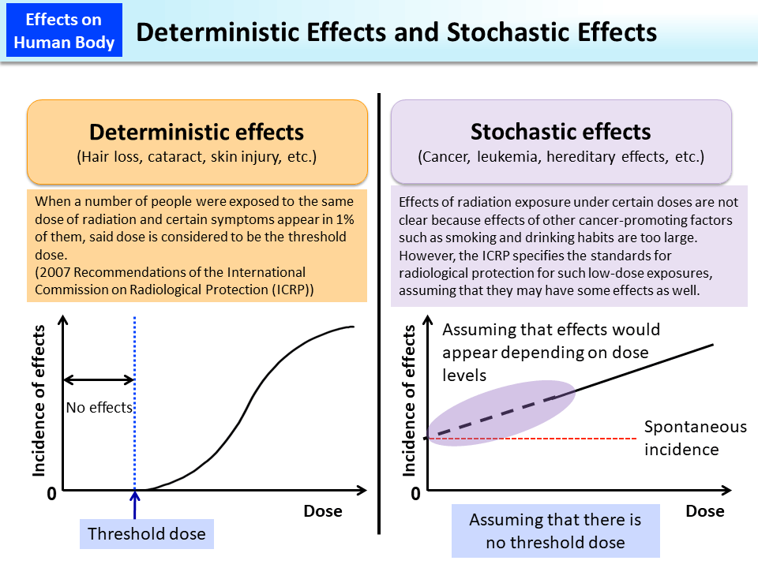
Effects of Radiation
The effects of radiation on living organisms can be divided into two main categories: deterministic effects and stochastic effects. These effects depend on various factors, including the type of radiation, the dose received, and the duration of exposure.

Slide 6

Thermoluminescence Dosimetry

Slide 7
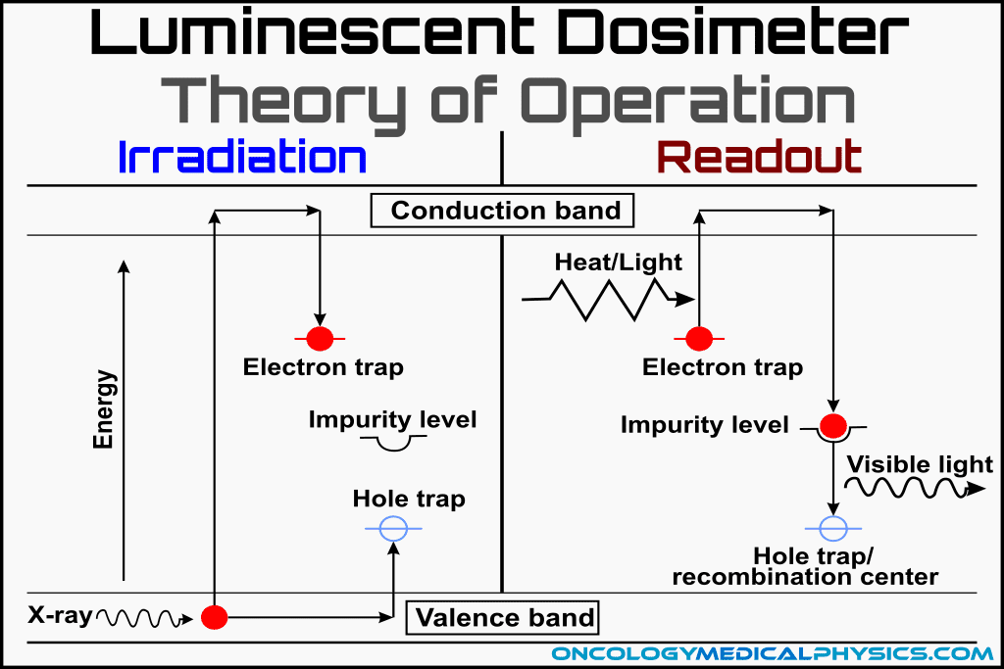
Thermoluminescence
Thermoluminescence (TL) is a luminescence phenomenon of an insulator or semiconductor which can be observed when the solid is thermally stimulated.
In order for a material to be thermoluminous, it must first be an insulator or a semiconductor because metals do not show thermoluminescence.
Energy must have been absorbed by the substance at some point while it was exposed to ionising radiation.
Material must be heated for luminescence to occur

Slide 8
Properties of ideal dosimeter
Accuracy: An ideal dosimeter should provide accurate measurements of radiation doses.
Sensitivity: The dosimeter should be highly sensitive to radiation, capable of detecting even low levels of radiation exposure.
Stability: An ideal dosimeter should exhibit stability over time, meaning its response to radiation doses remains consistent throughout its operational lifespan.
Energy Dependence: The dosimeter should have minimal energy dependence, meaning it should provide consistent dose measurements across a broad range of radiation energies and types
Linearity: The dosimeter’s response should be linear across a wide range of dose levels.
Tissue-Equivalent: An ideal dosimeter should mimic the radiation absorption characteristics of human tissue.
•
•
•

Slide 9

Lithium metasilicate Li₂SiO₃

Slide 10
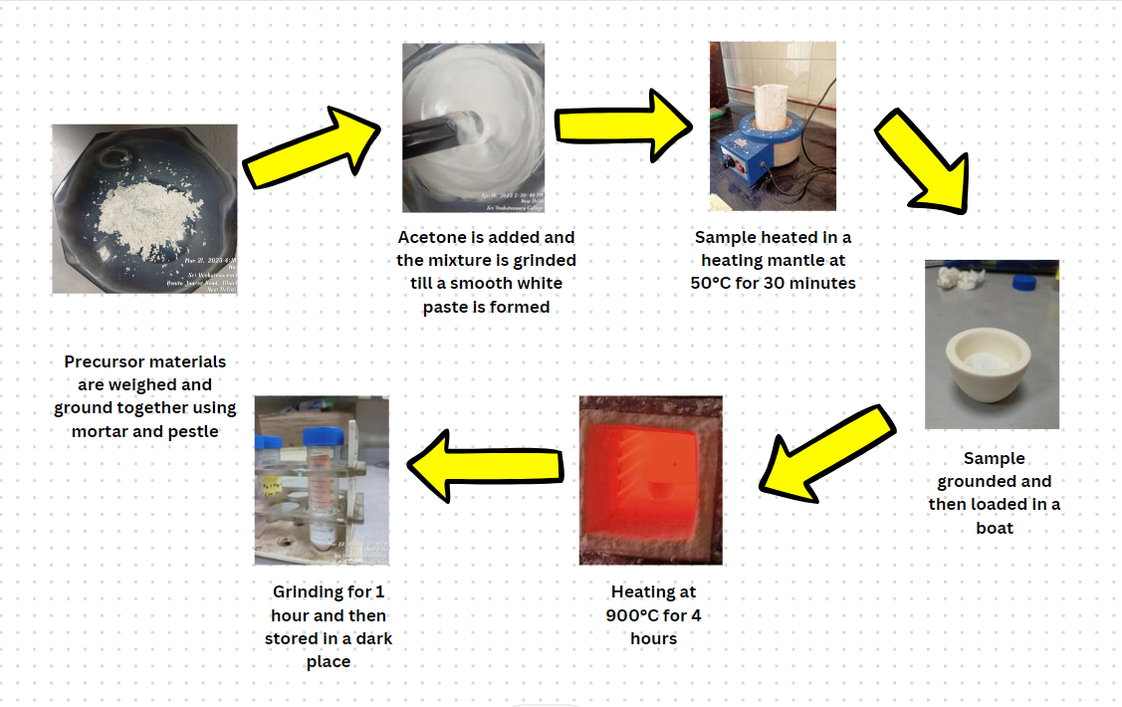
Synthesis
•
•
•

Slide 11
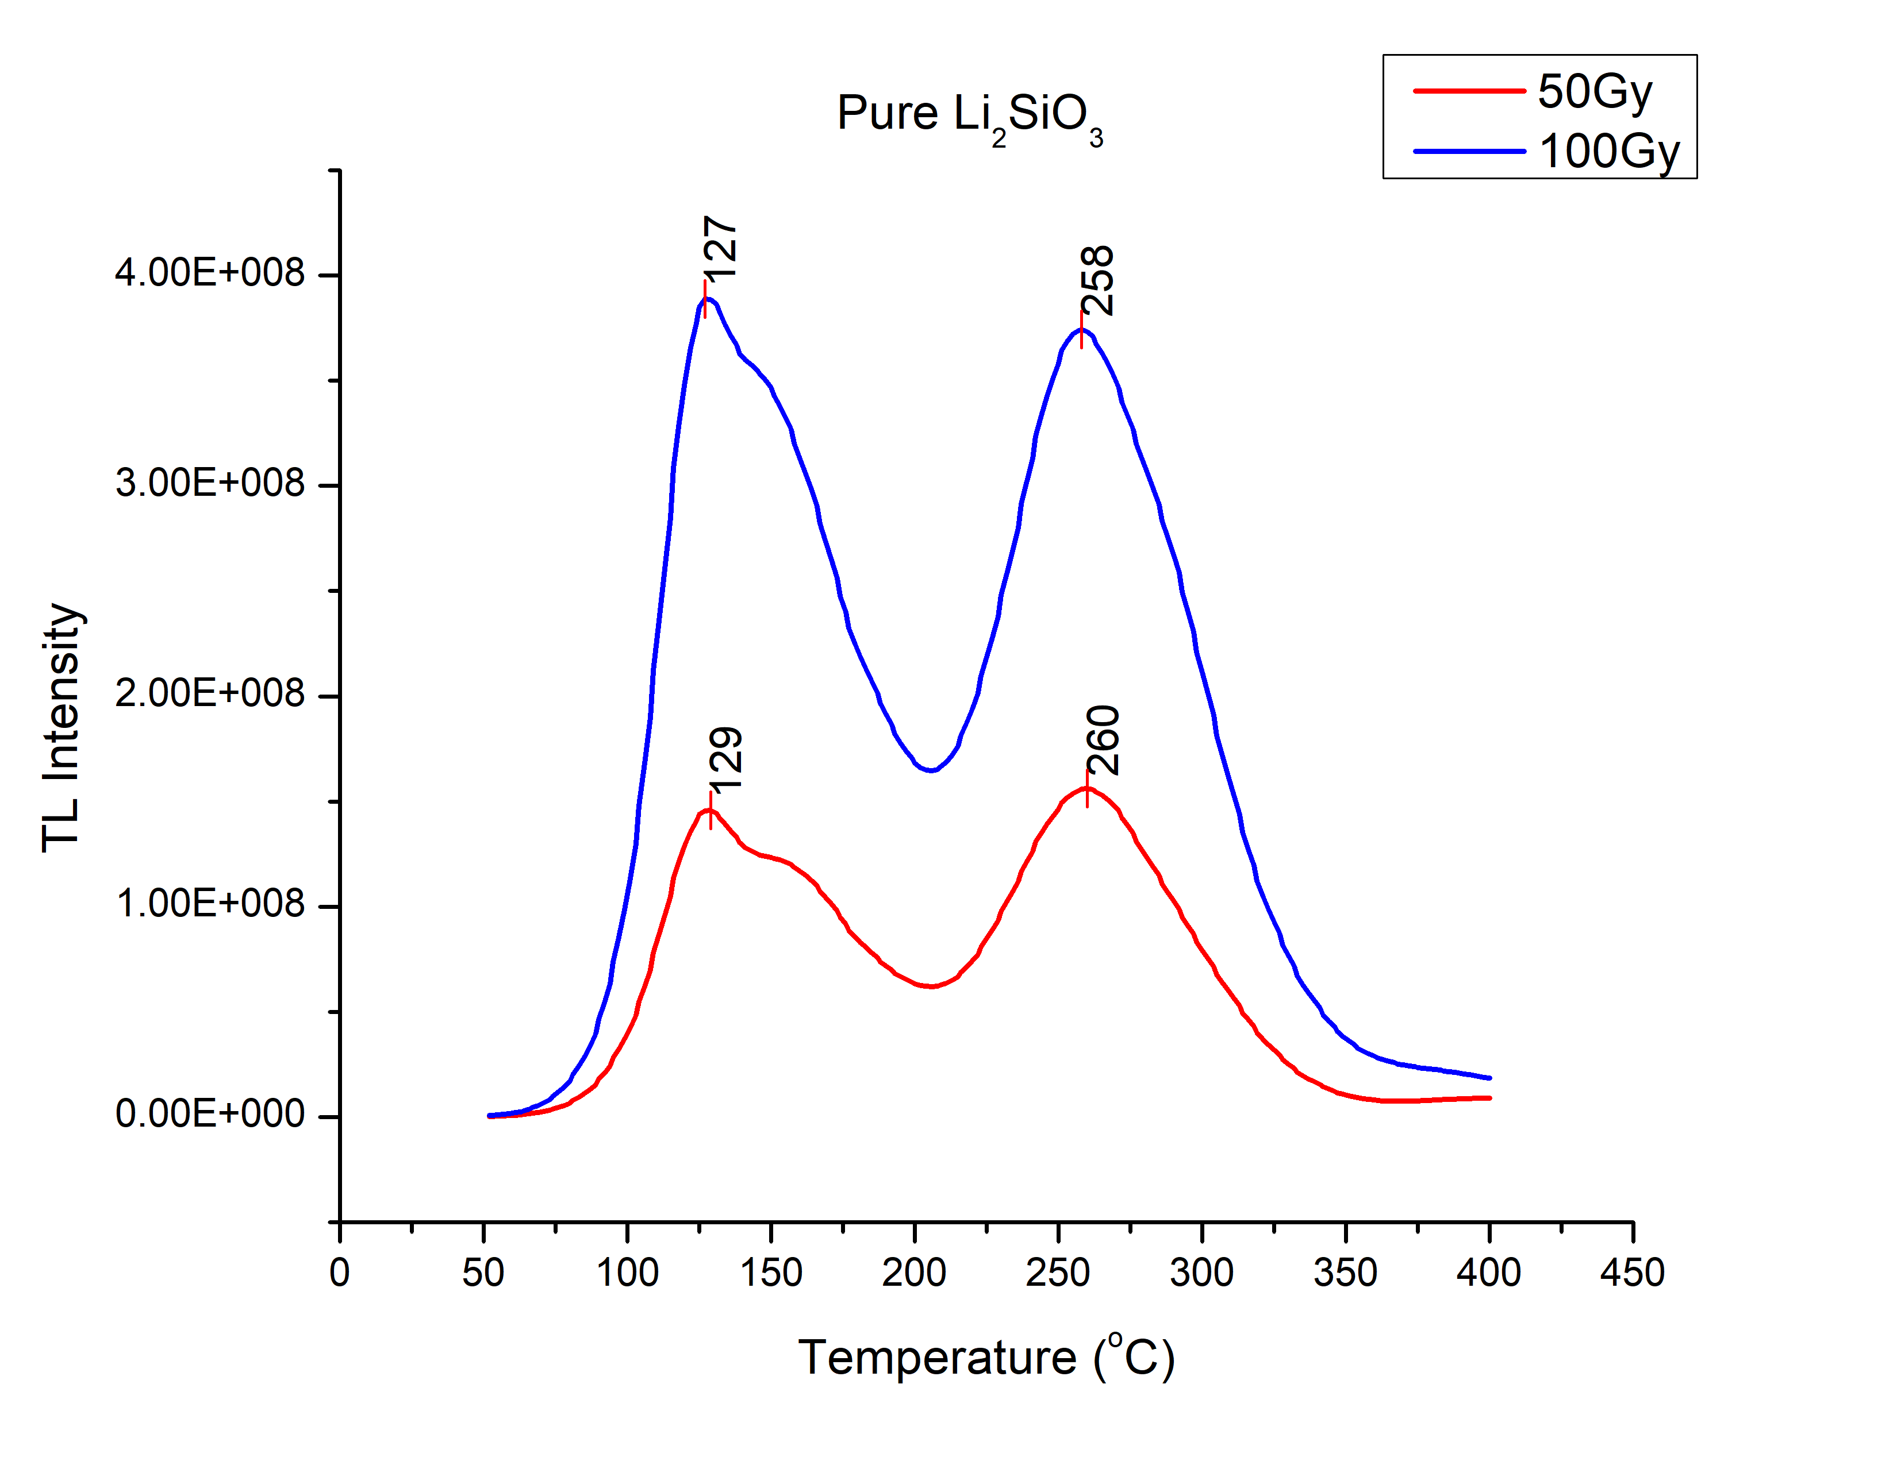
Glow Curves
•
•
•

Slide 12
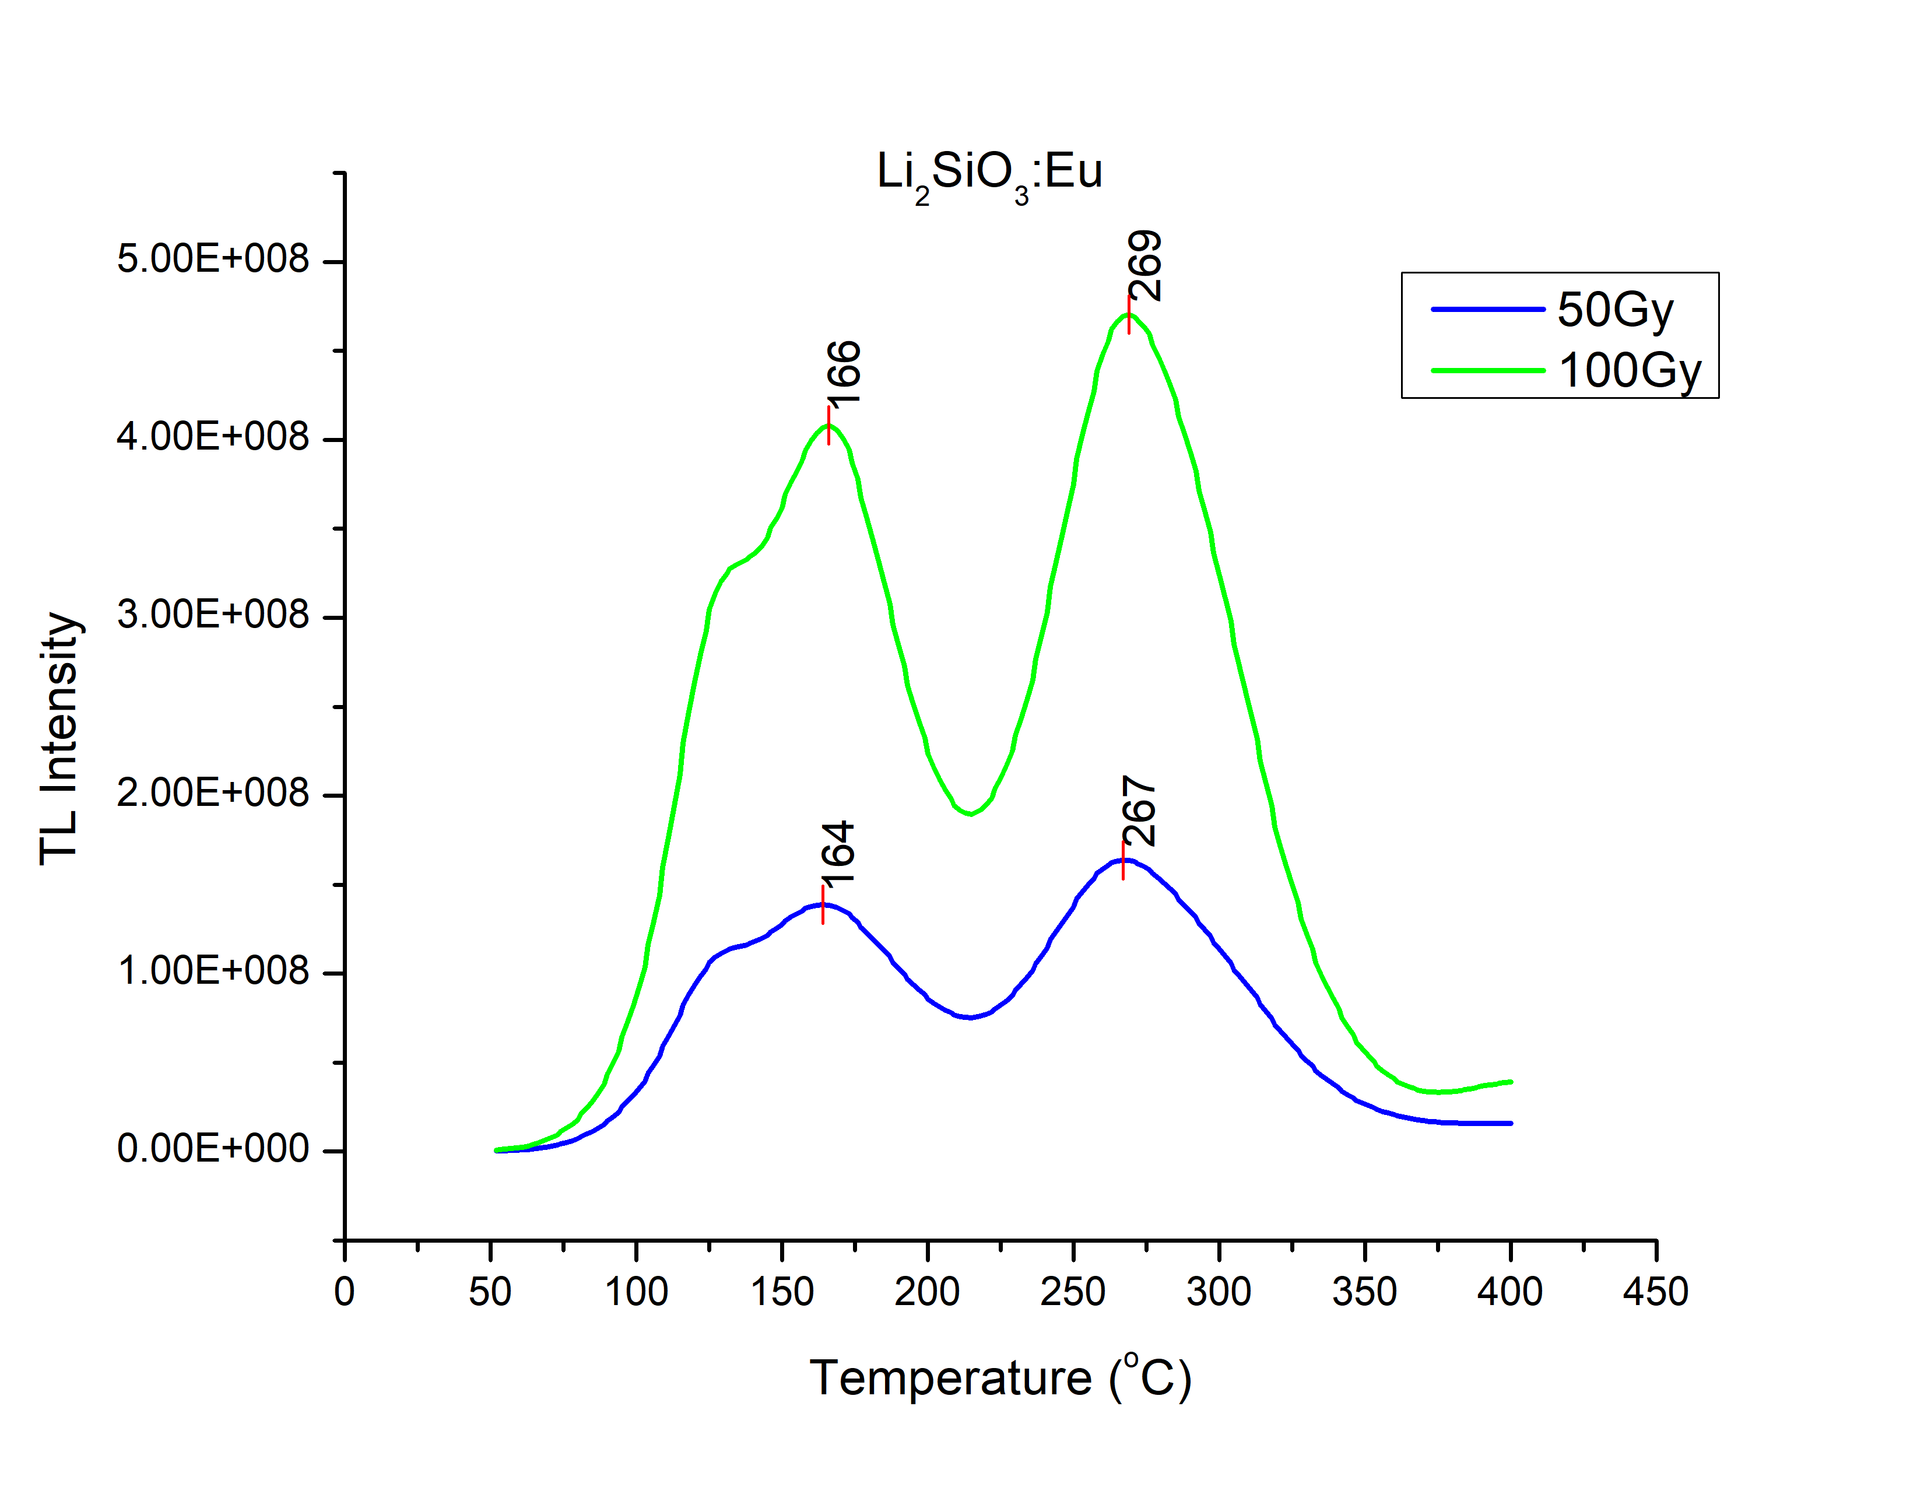
Glow Curves
•
•
•

Slide 13
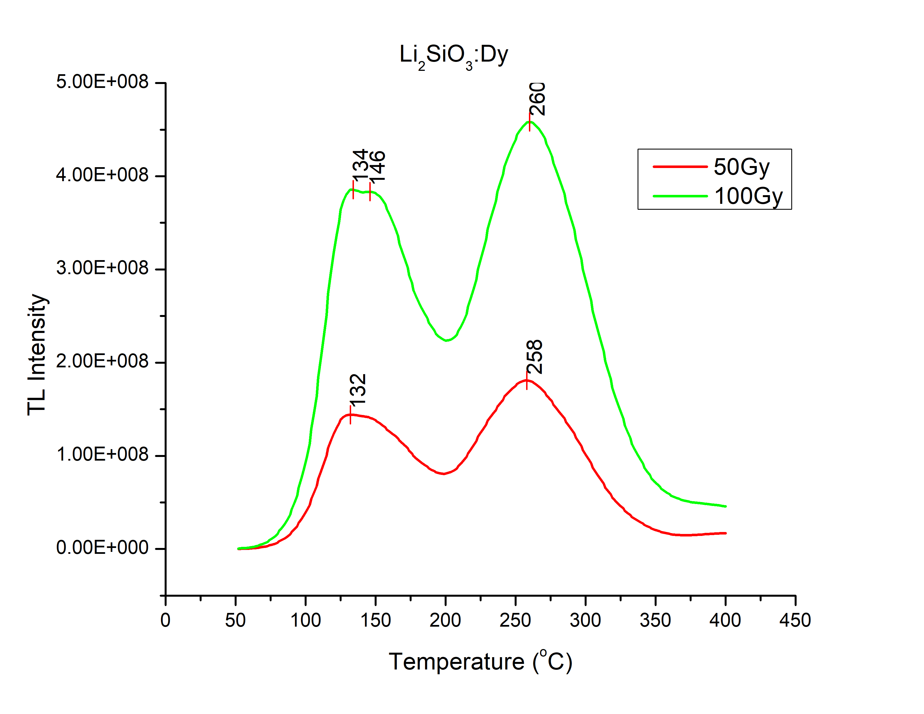
Glow Curves
•
•
•

Slide 14
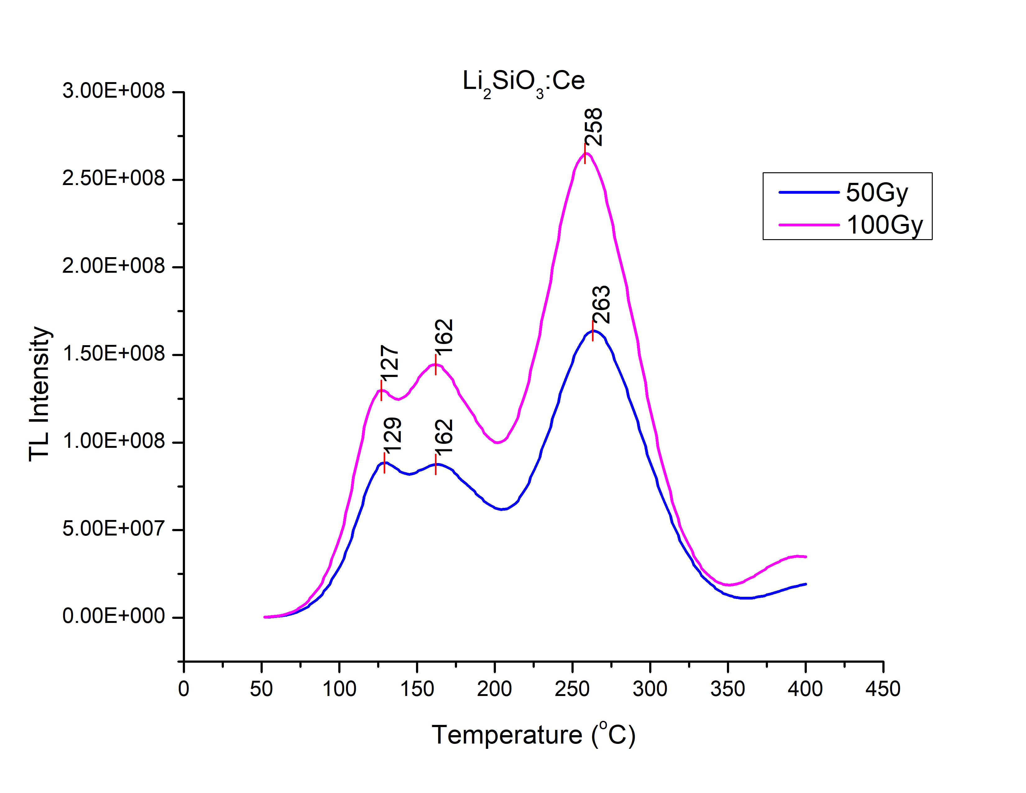
Glow Curves
•
•
•

Slide 15
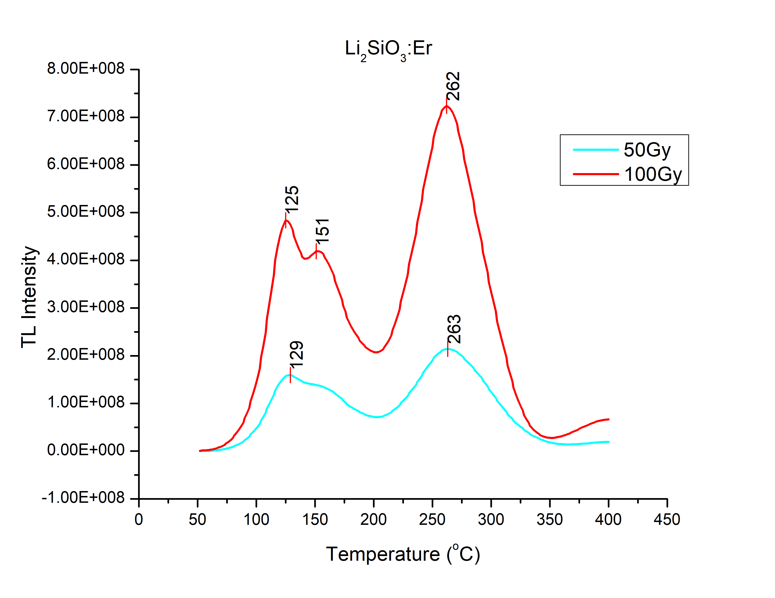
Glow Curves
•
•
•

Slide 16
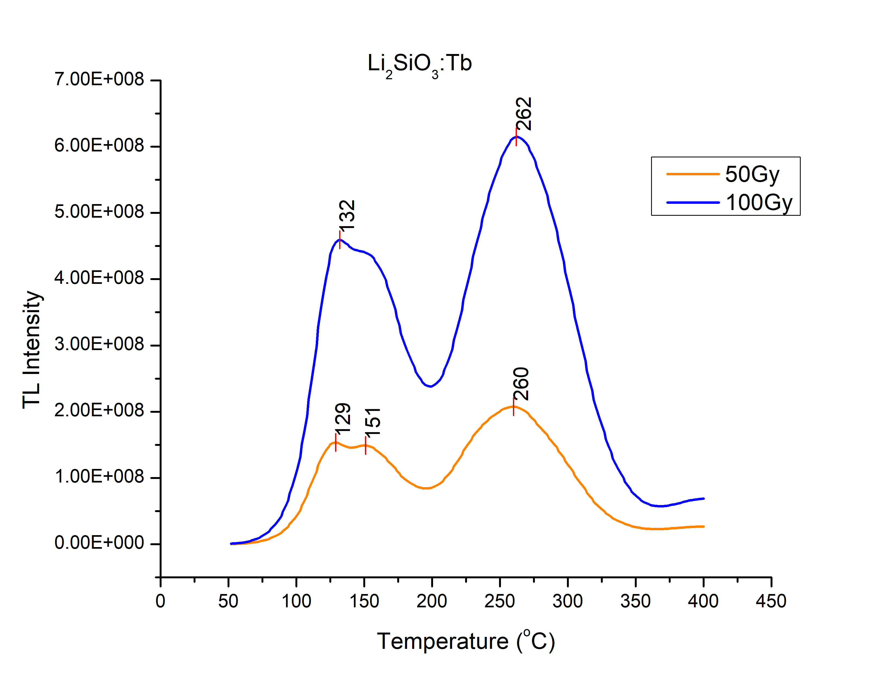
Glow Curves
•
•
•

Slide 17
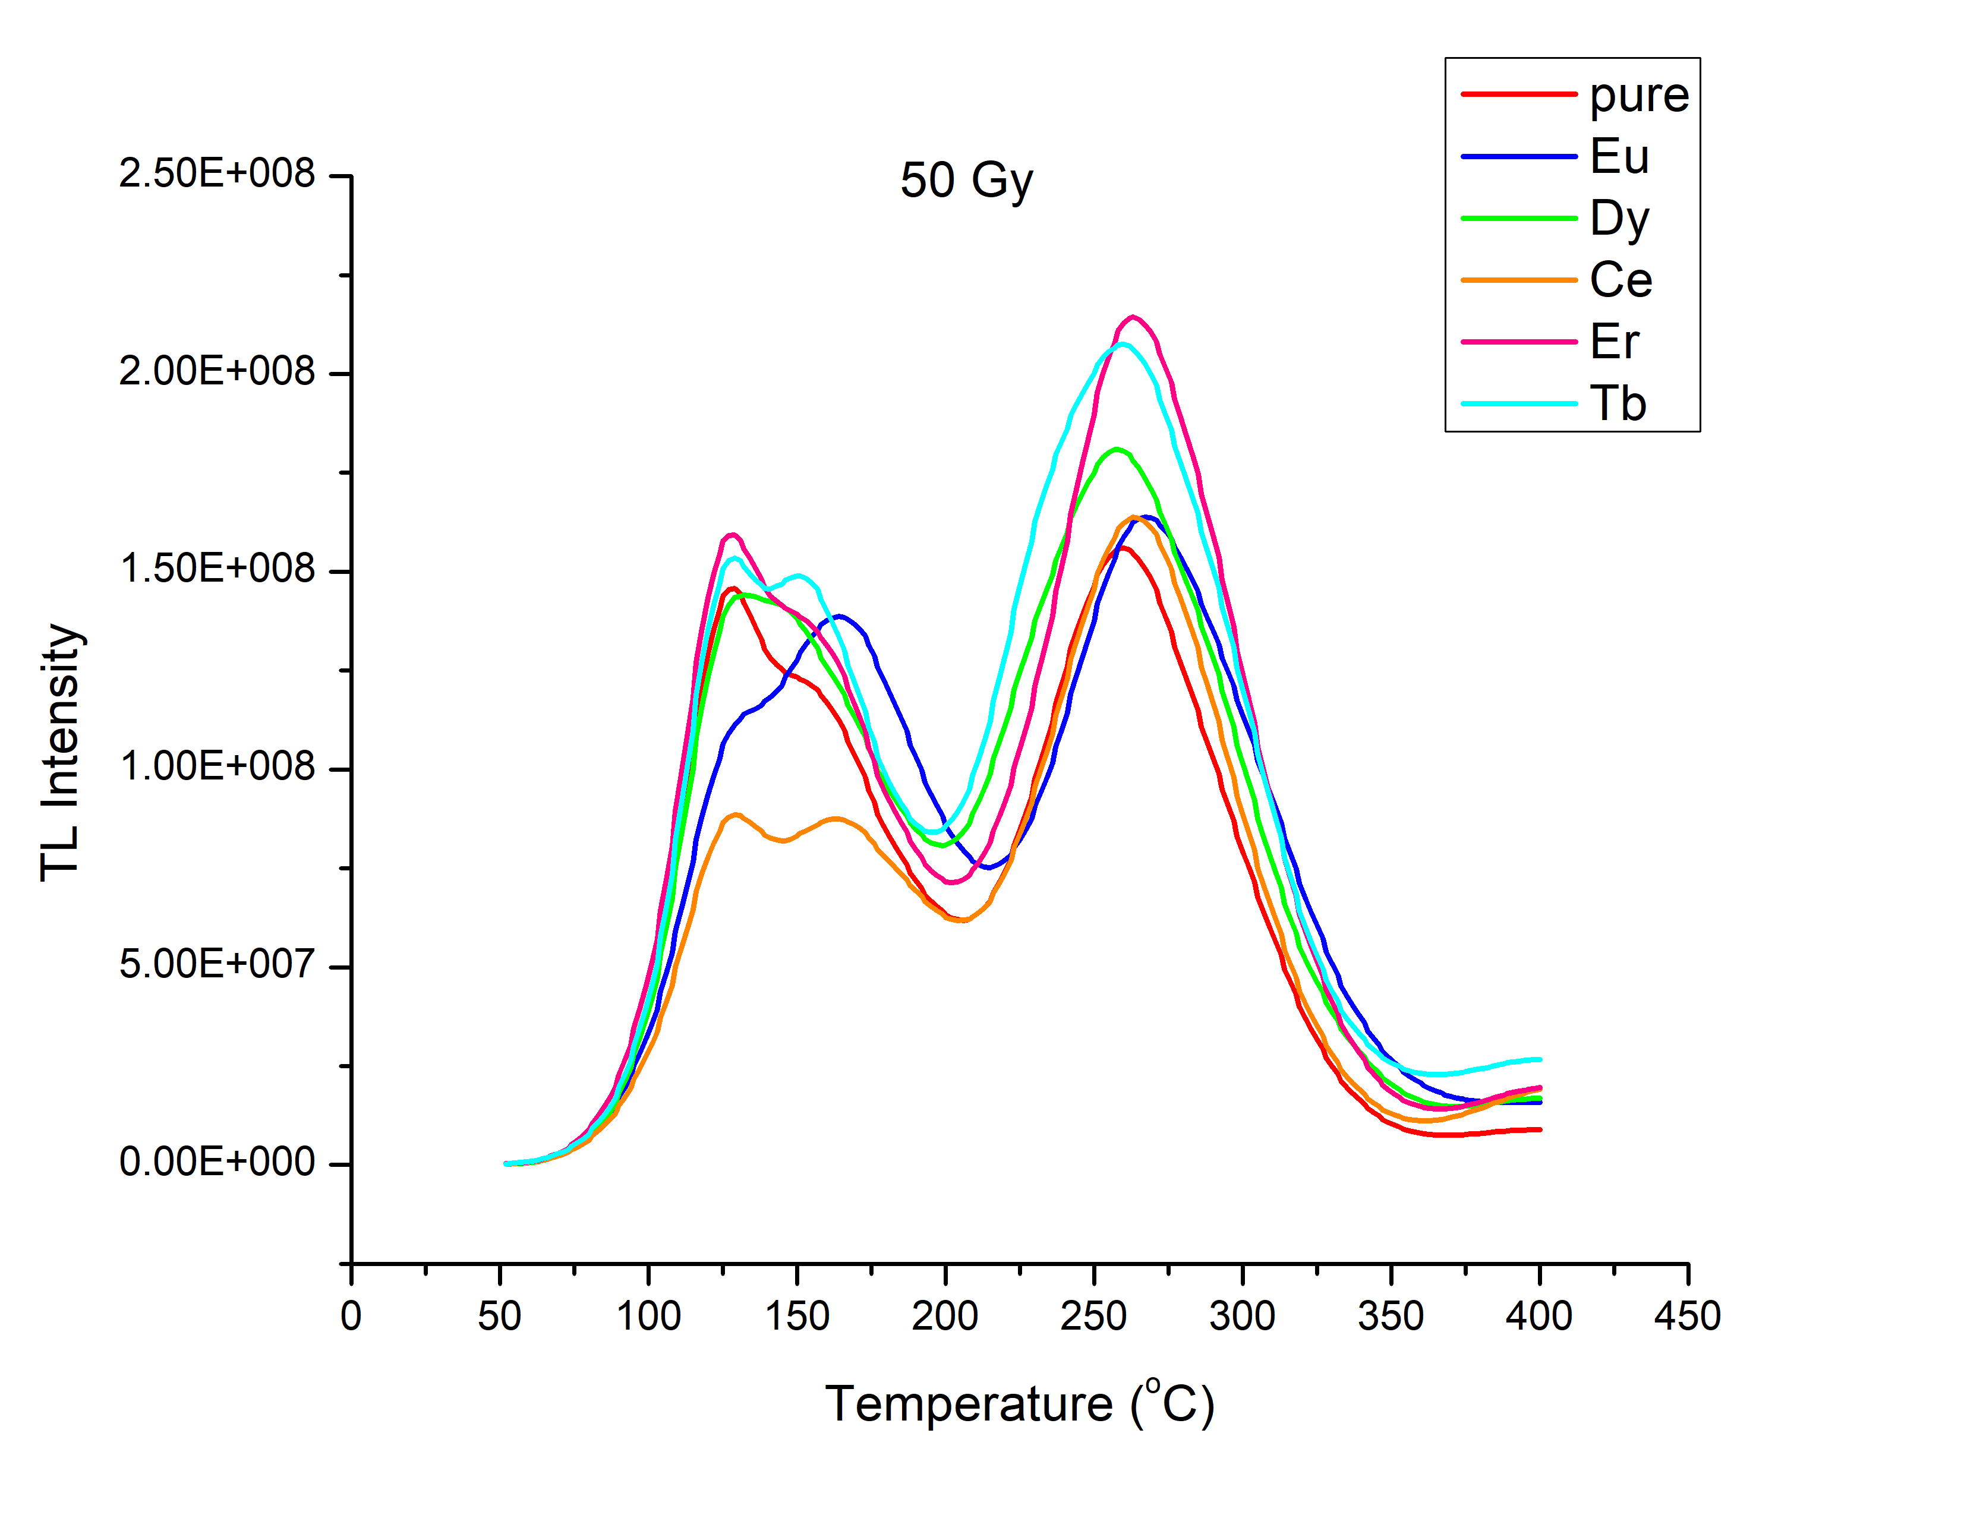
Dopant Optimization
•
•
•

Slide 18
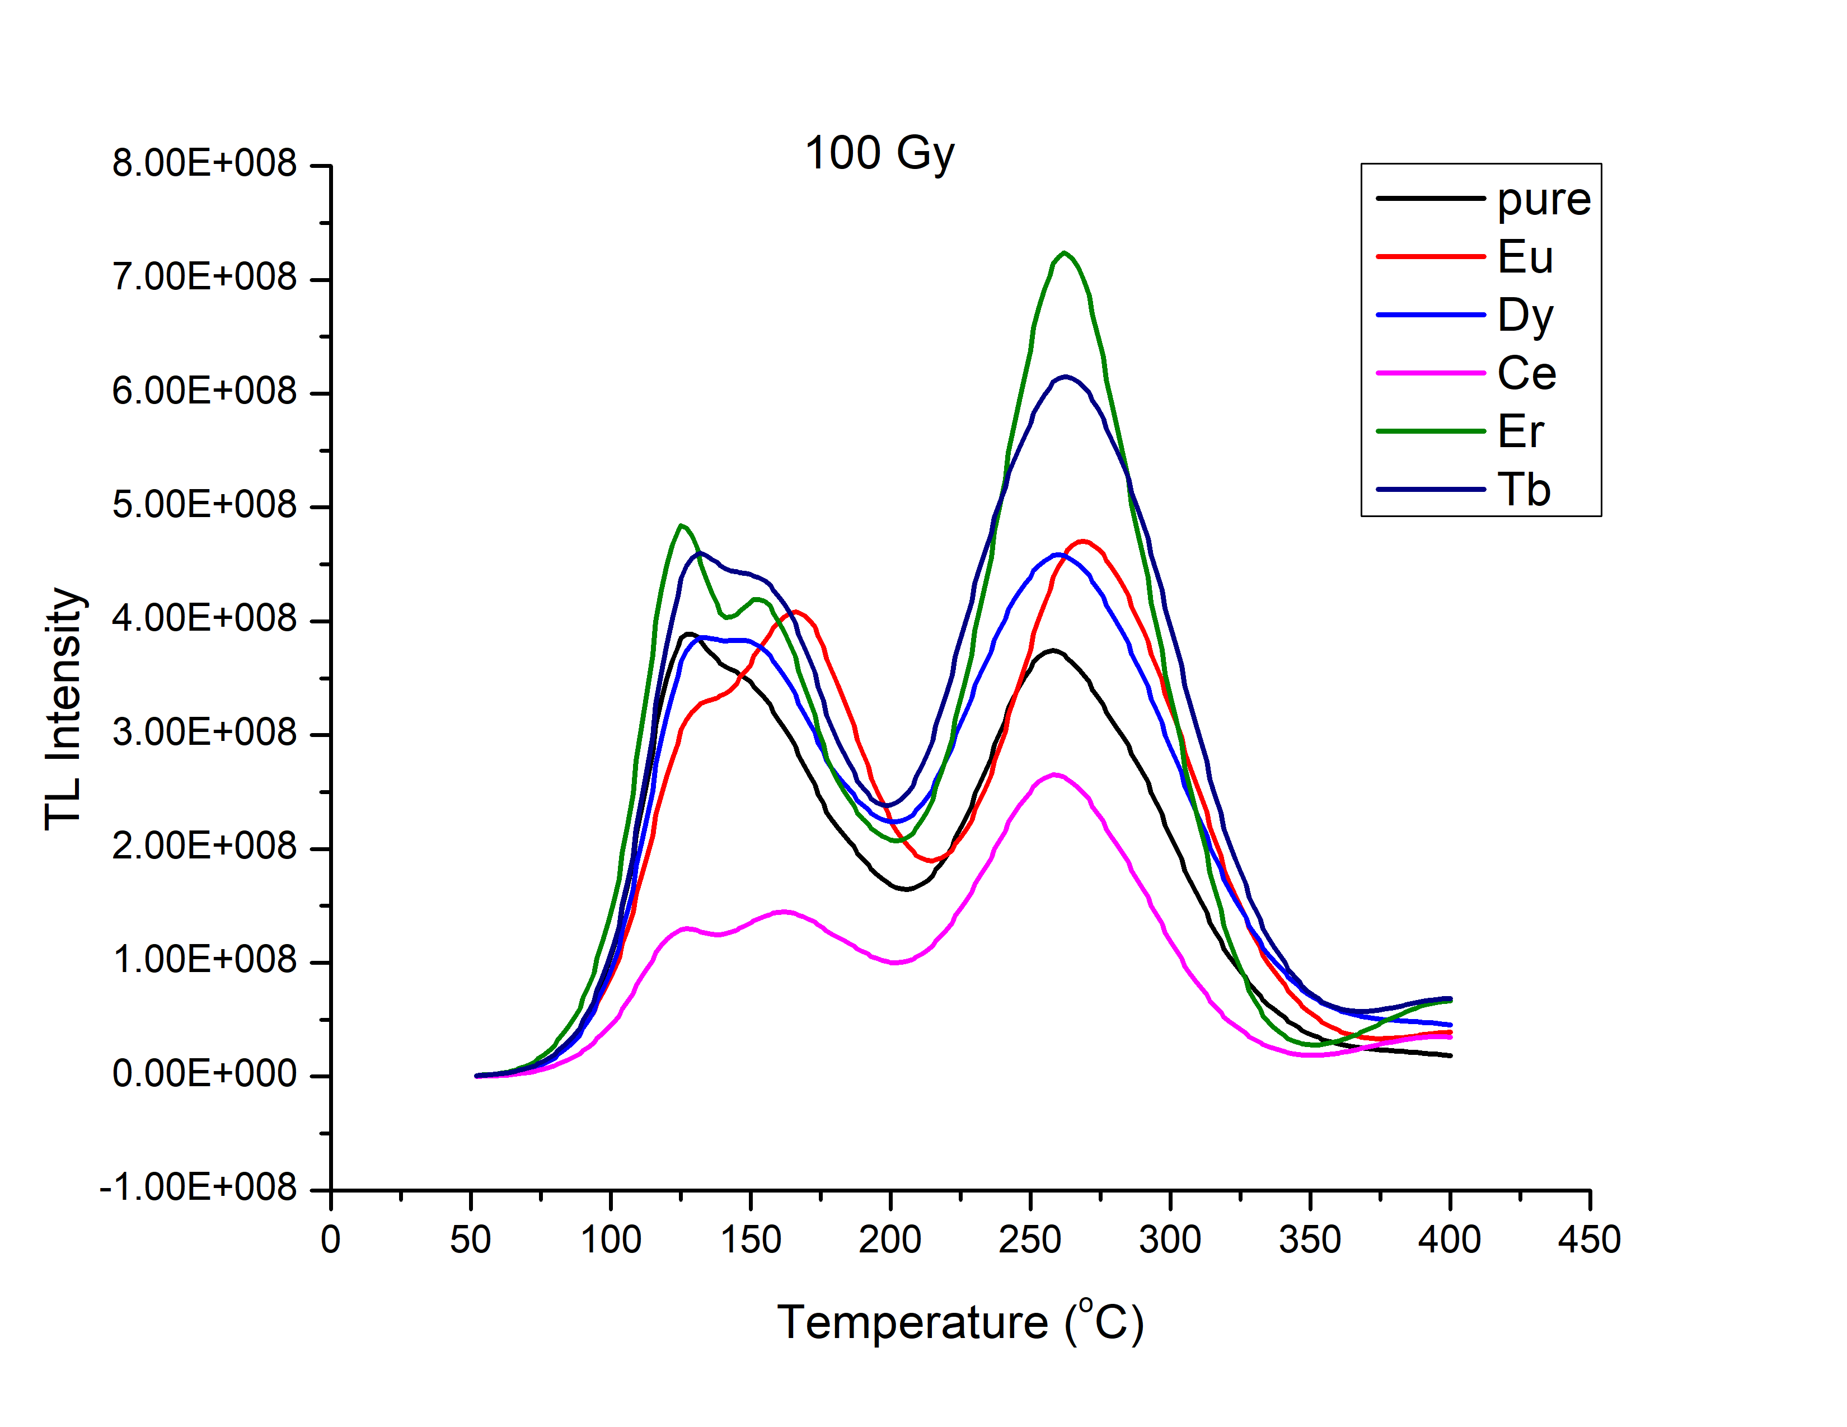
Dopant Optimization
•
•
•

Slide 19
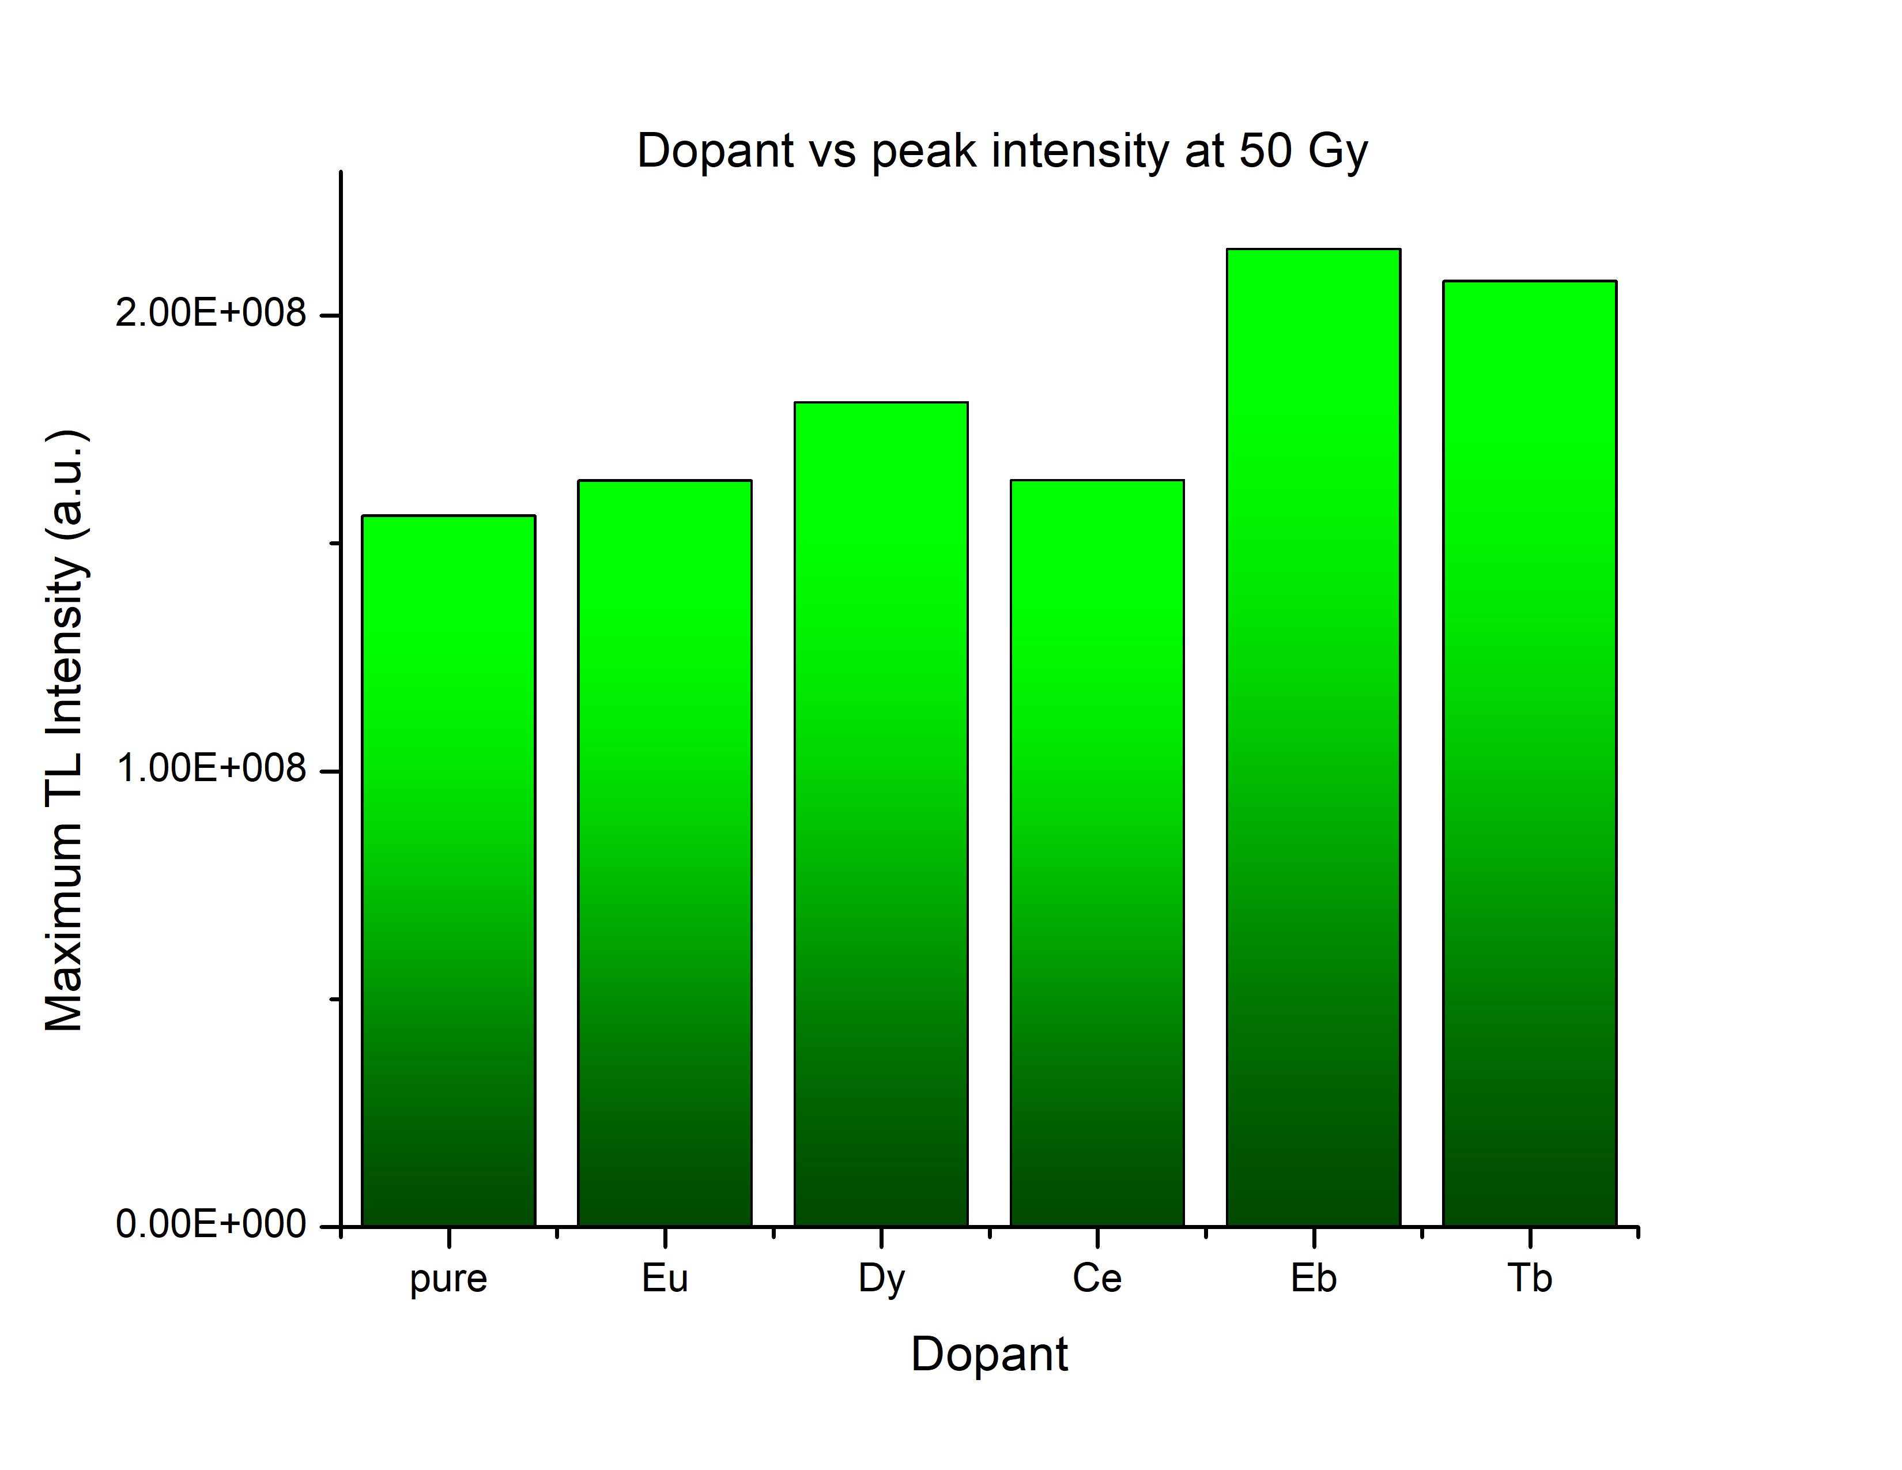
Dopant Optimization
•
•
•

Slide 20
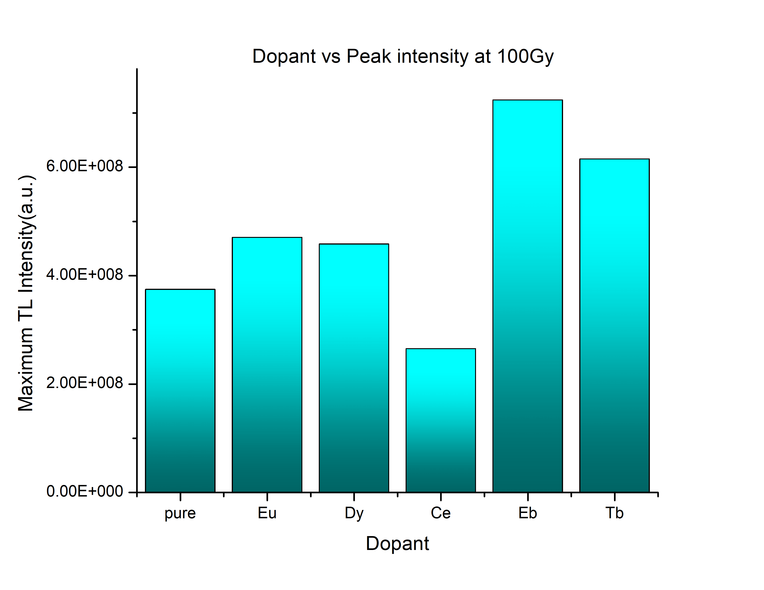
Dopant Optimization
•
•
•

Slide 21

Calcium Sodium Sulphate CaNa₂(SO₄)₂

Slide 22

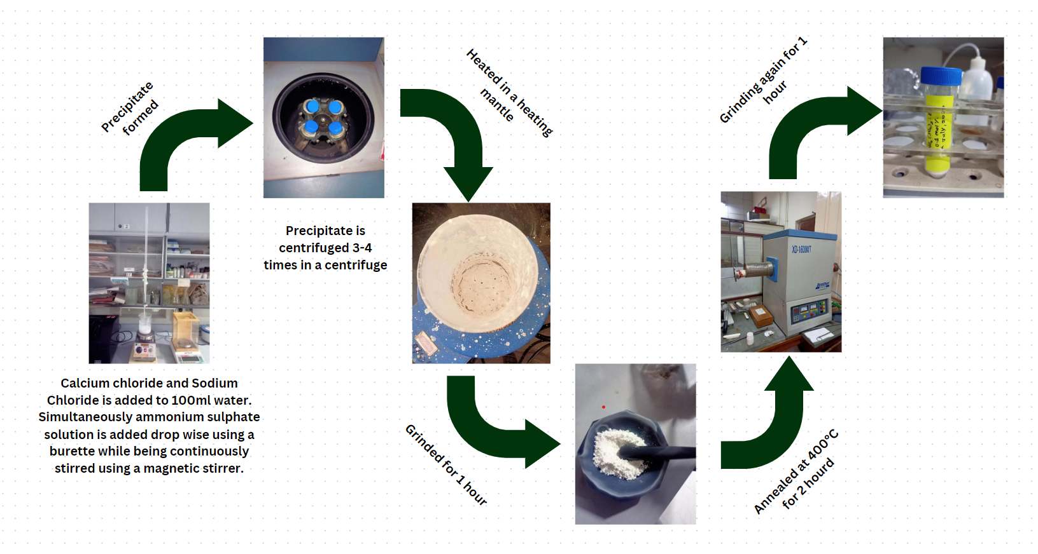
Synthesis

Slide 23
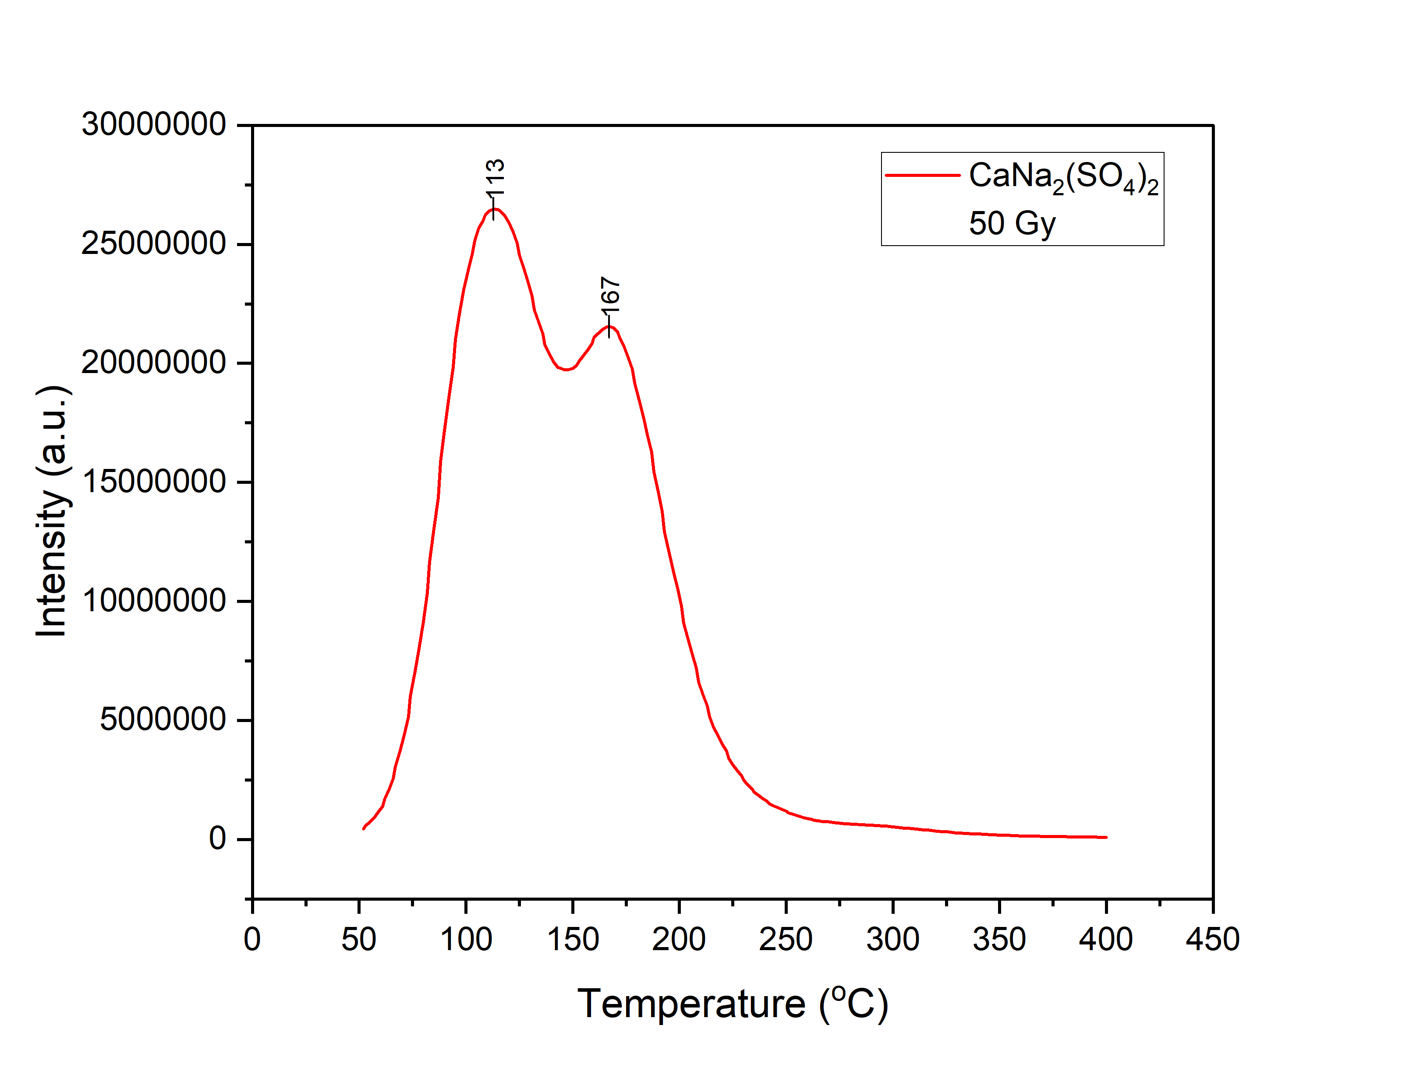
TL Glow Curves

Slide 24
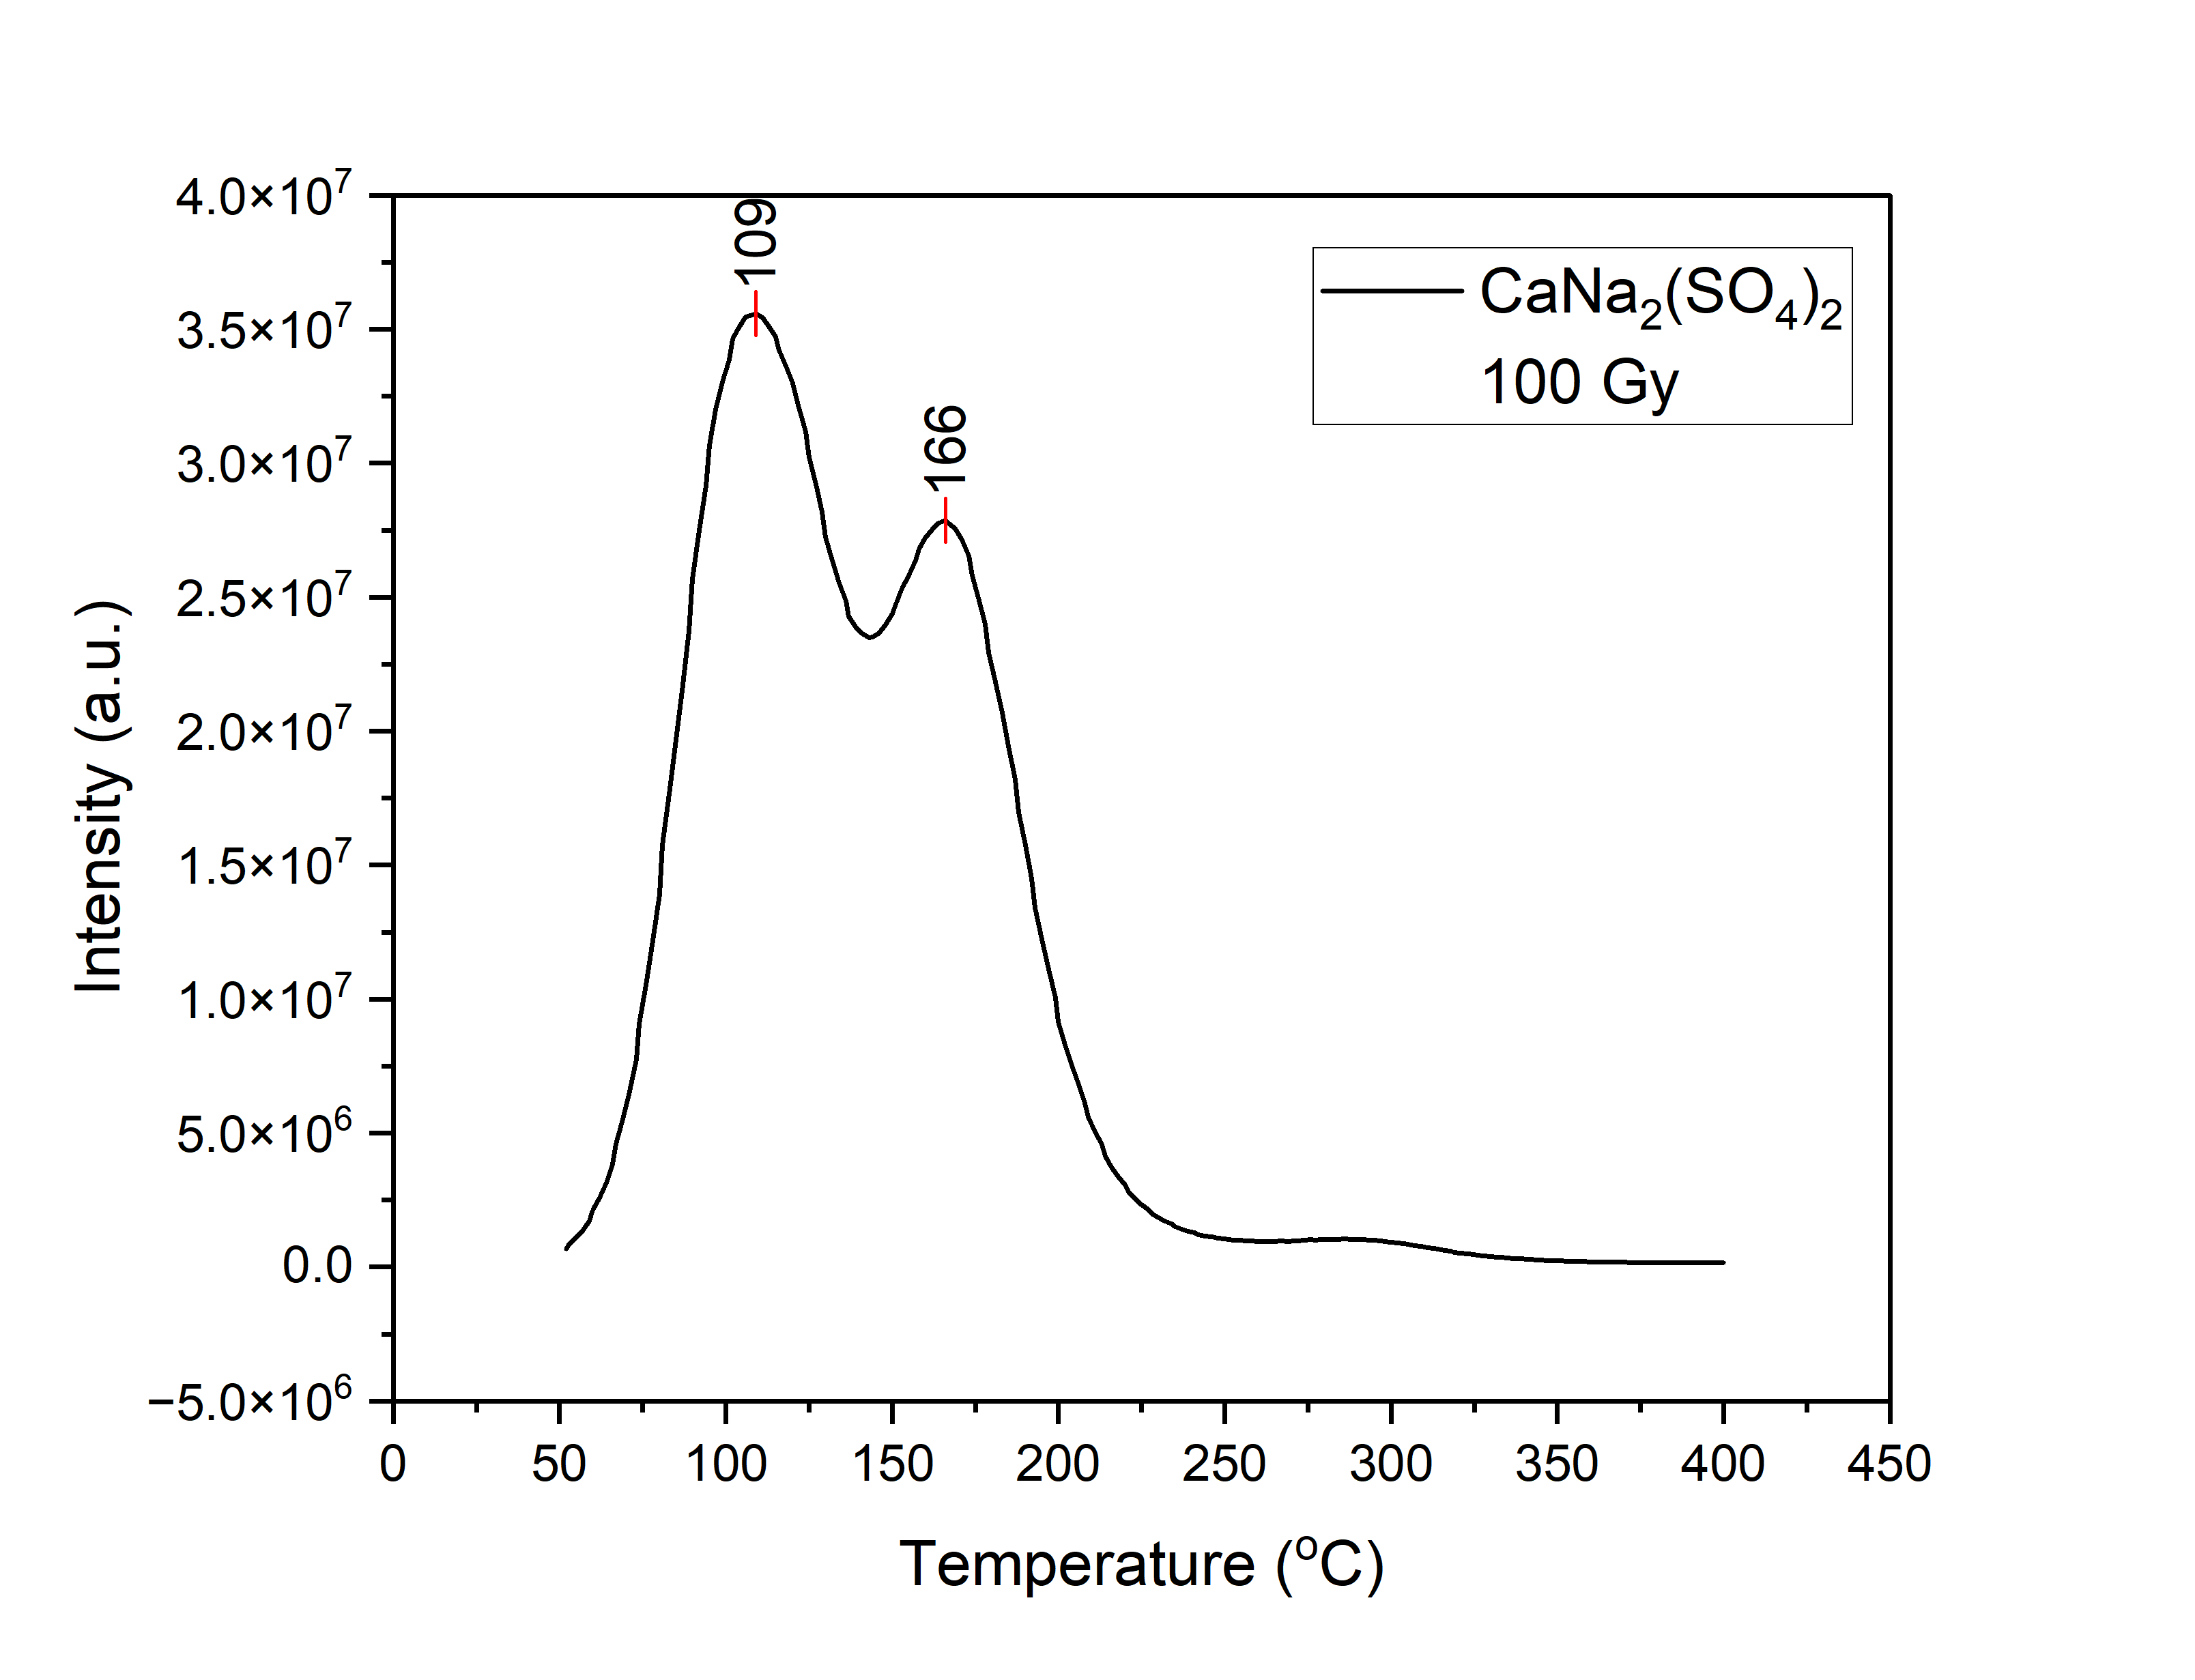
TL Glow Curves

Slide 25
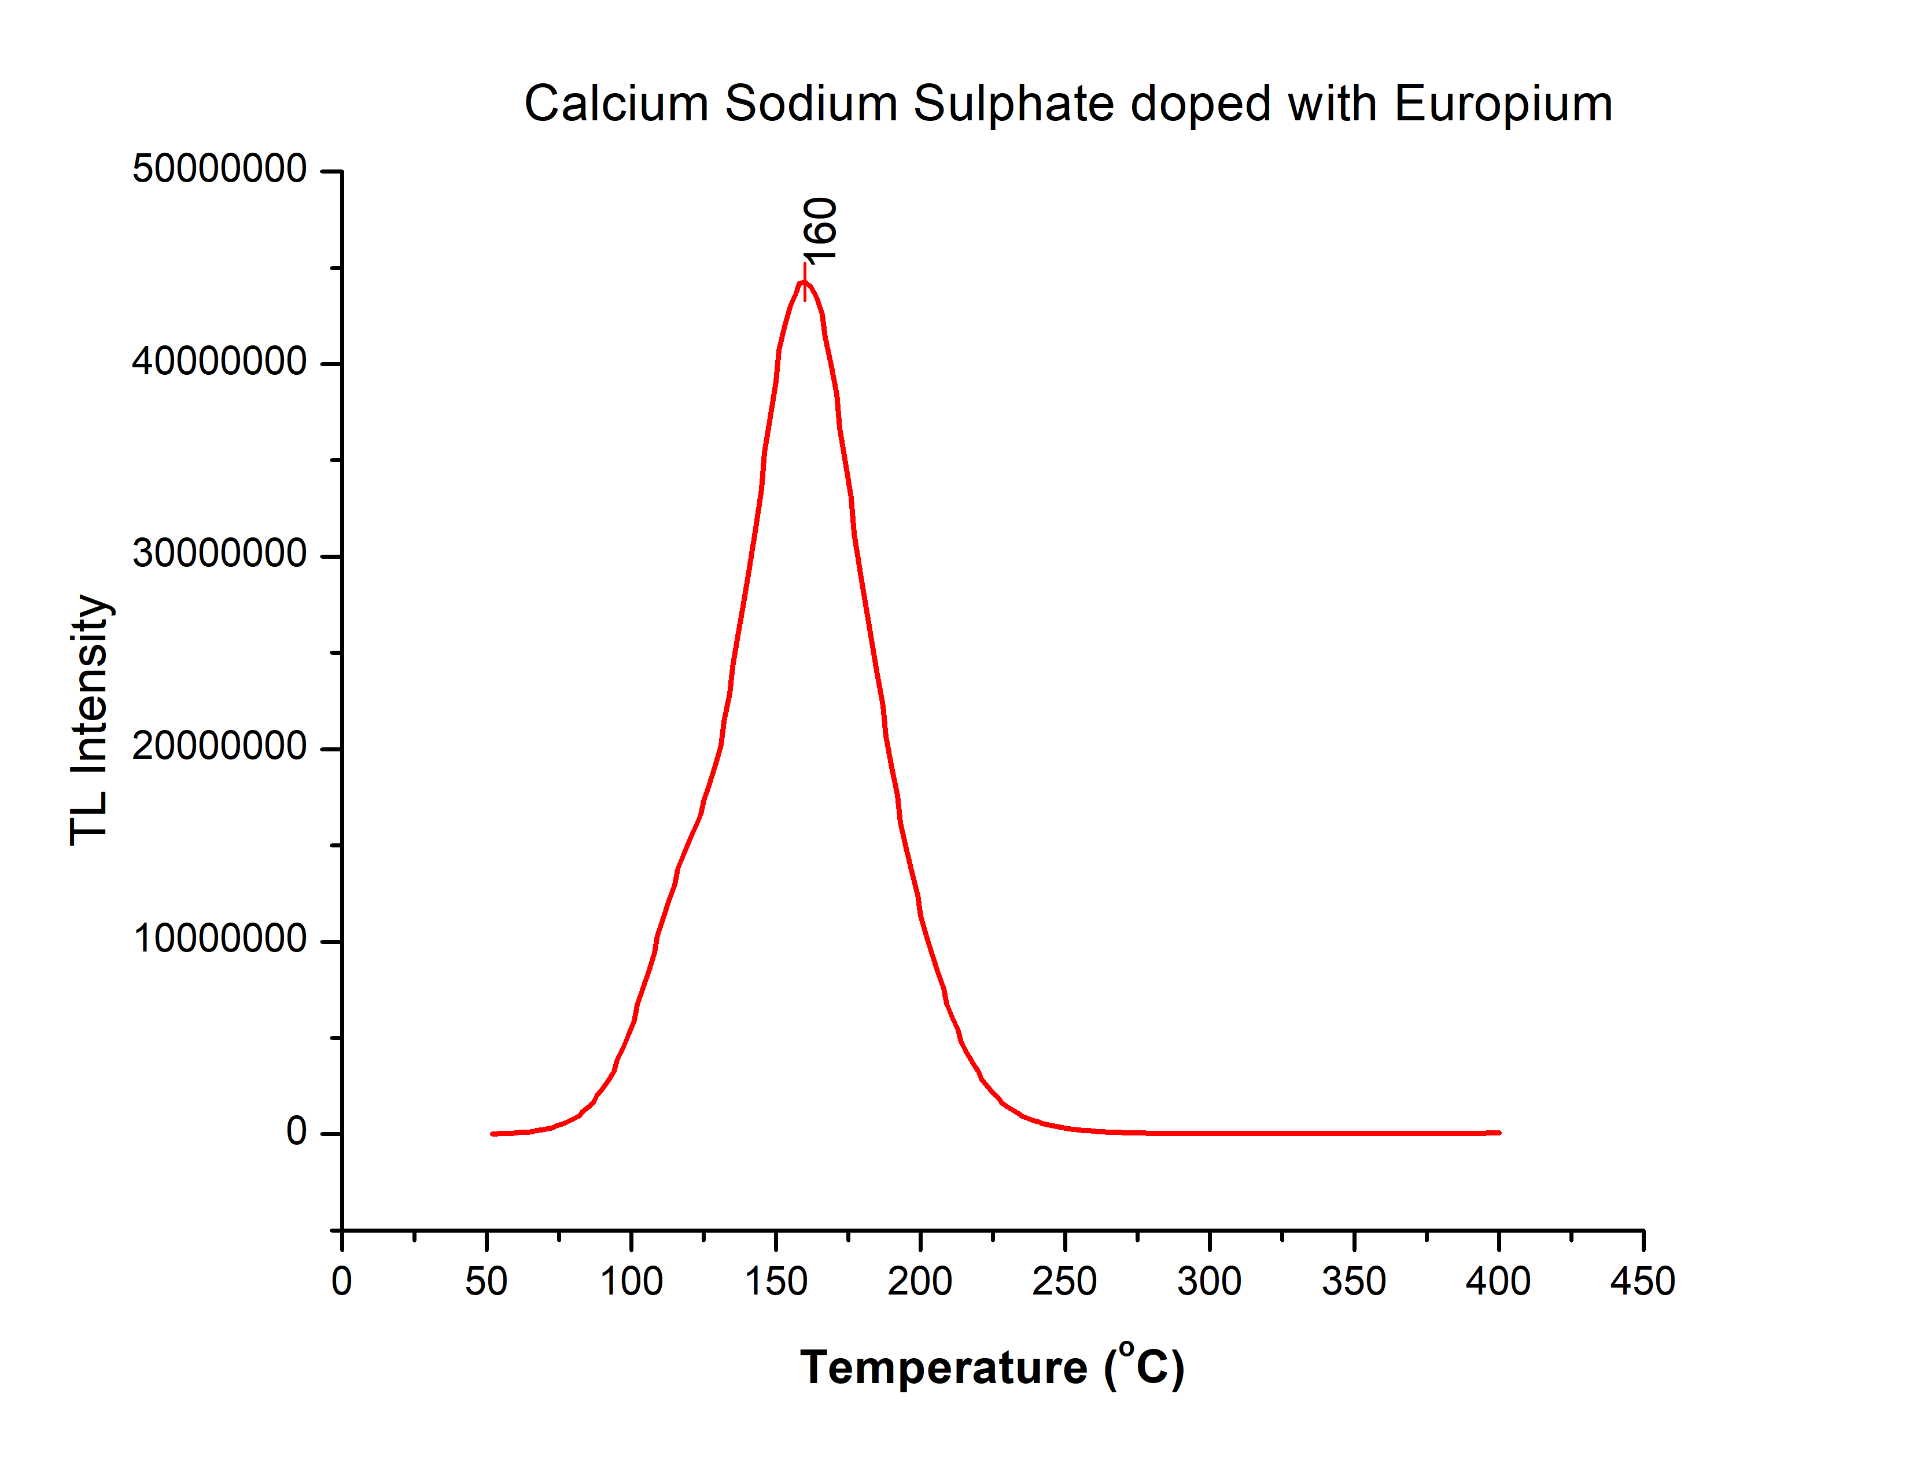
TL Glow Curves

Slide 26
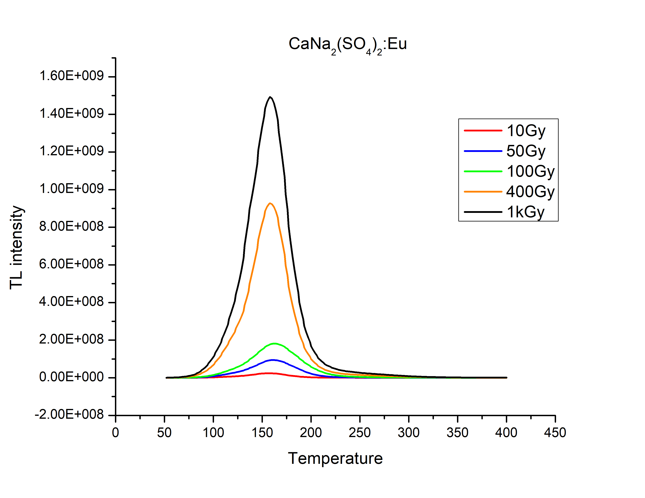
Dose Response

Slide 27
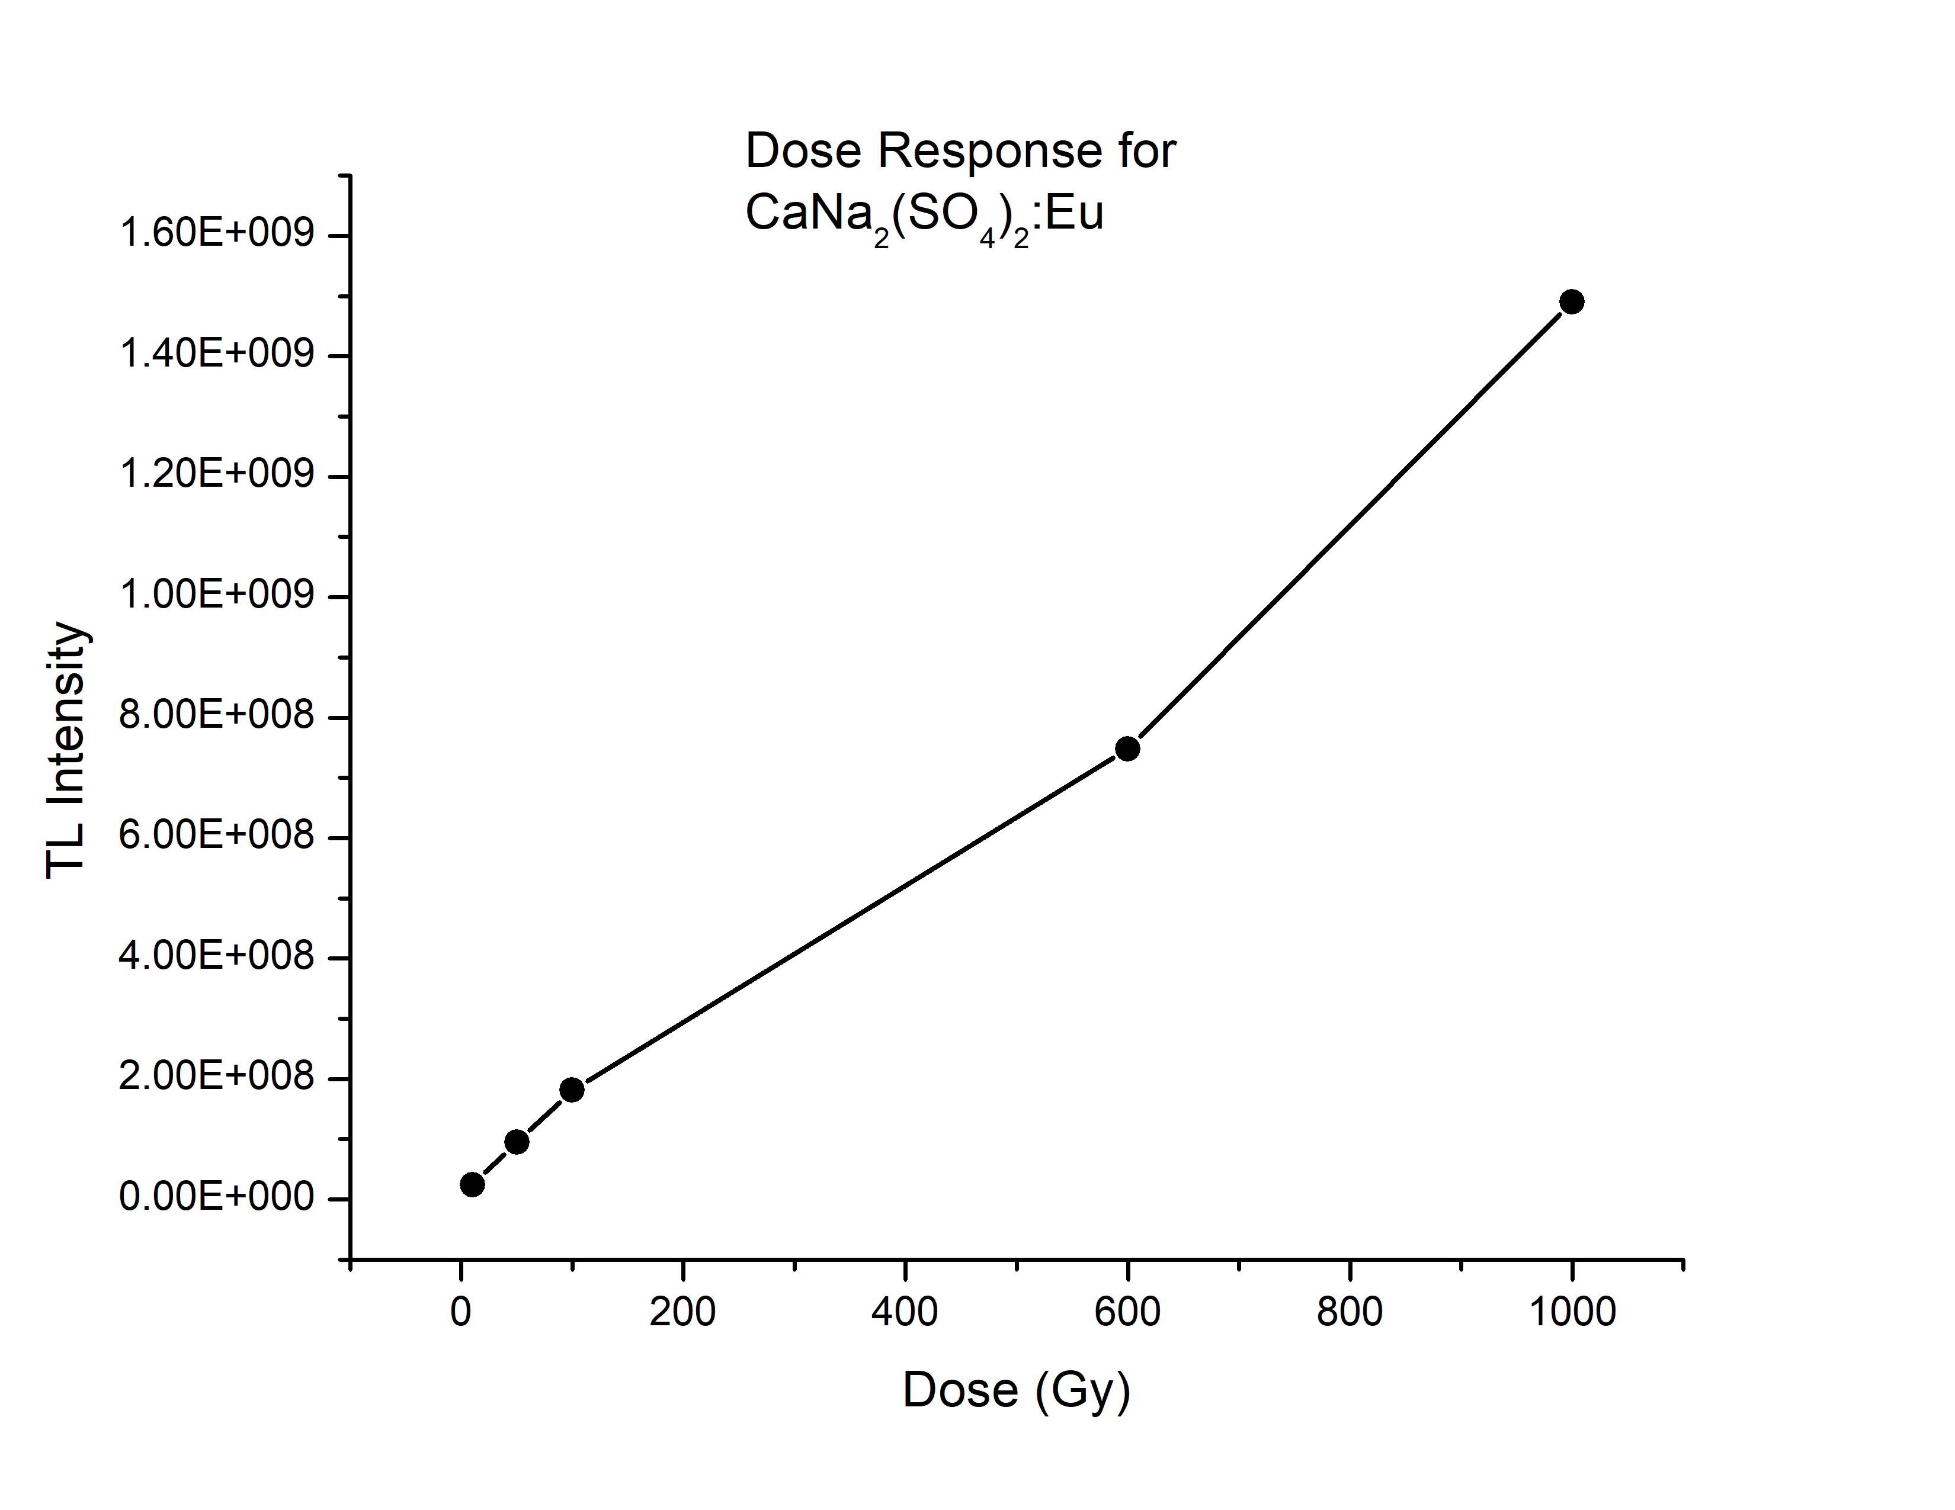
Dose Response

Slide 28
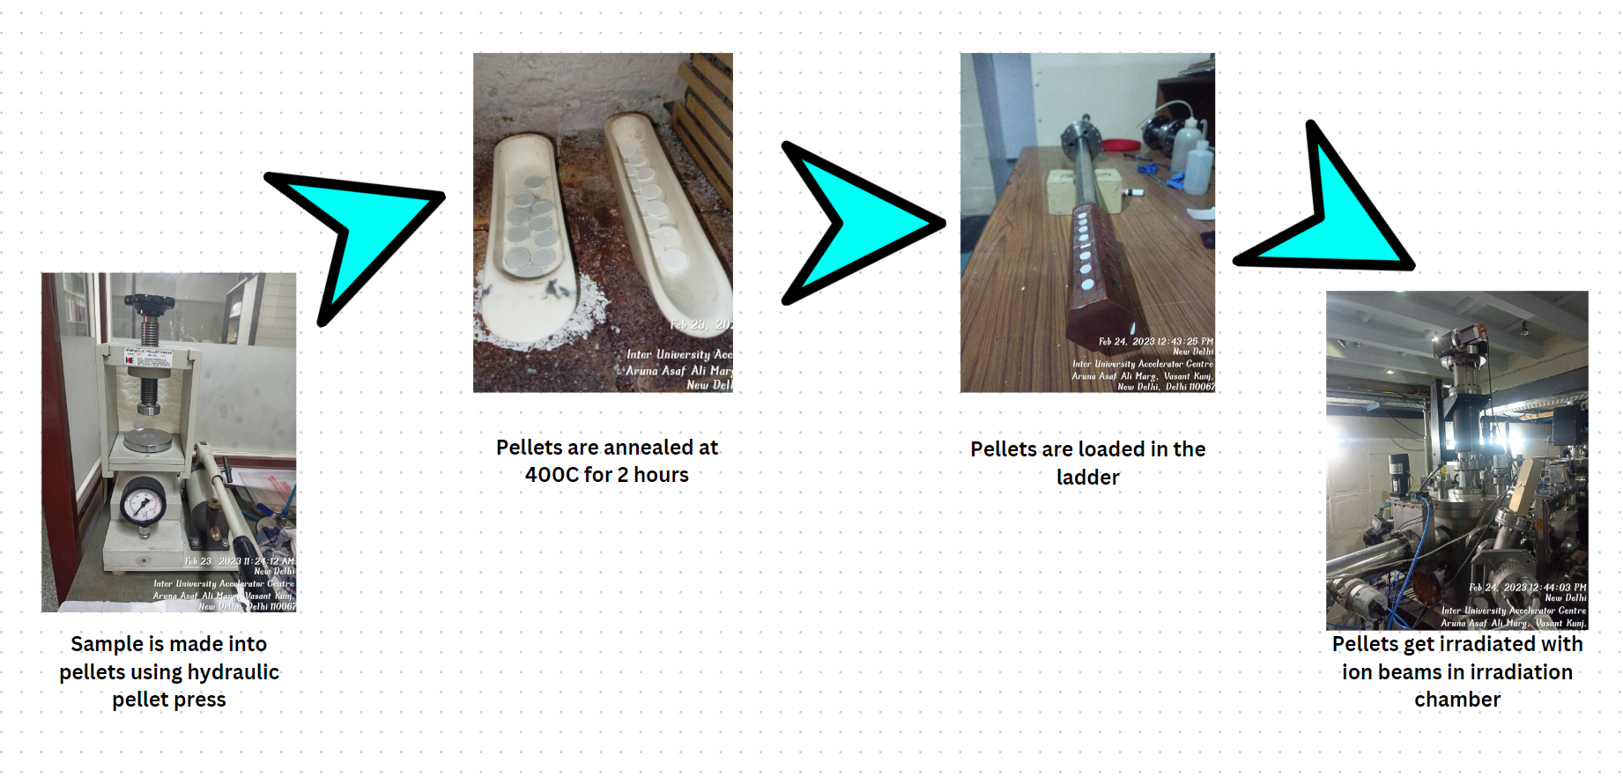
Ion Beam Irradiation

Slide 29

CONCLUSION

Slide 30
Lithium metasilicate
The main feature of lithium metasilicate is its high sensitivity to ionizing radiation for a wide energy range.
Also, Li₂SiO₃ (Zef f = 10.5) being low Z materials, are near tissue equivalent and may find application in the field of radiation dosimetry.
Lithium metasilicate yields glow curves with two to three major peaks.
On addition of dopants, the thermoluminescence intensities in much higher than that of undoped sample.
Doping with Terbium and Erbium results in maximum intensities for 50 Gy and 100 Gy gammma irradiation.

Slide 31
Calcium sodium sulphate
The TL glow curve of CaNa₂(SO₄)₂ shows 2 peaks at around 113◦ C and 167◦ C for 50 Gy dose and at around 109◦ C and 166◦ C for 100Gy dose.
The sample of CaNa₂(SO₄)₂ : Eu shows a very high intensity single TL glow peak at around 160 ◦ C.
This shows that the addition of dopant enhances the thermoluminescent properties of CaNa₂(SO₄)₂.

Slide 32


